Slide 1
Changing Face of Business Support
Josh Fegles, Palo Alto Software, maker of LivePlan
Using technology to increase business plan completion

Slide 2
LIVEPLAN PRESENTATION
for CAMEO
Palo Alto Software, Maker of LivePlan
PLAN
MANAGE
GROW

Slide 3
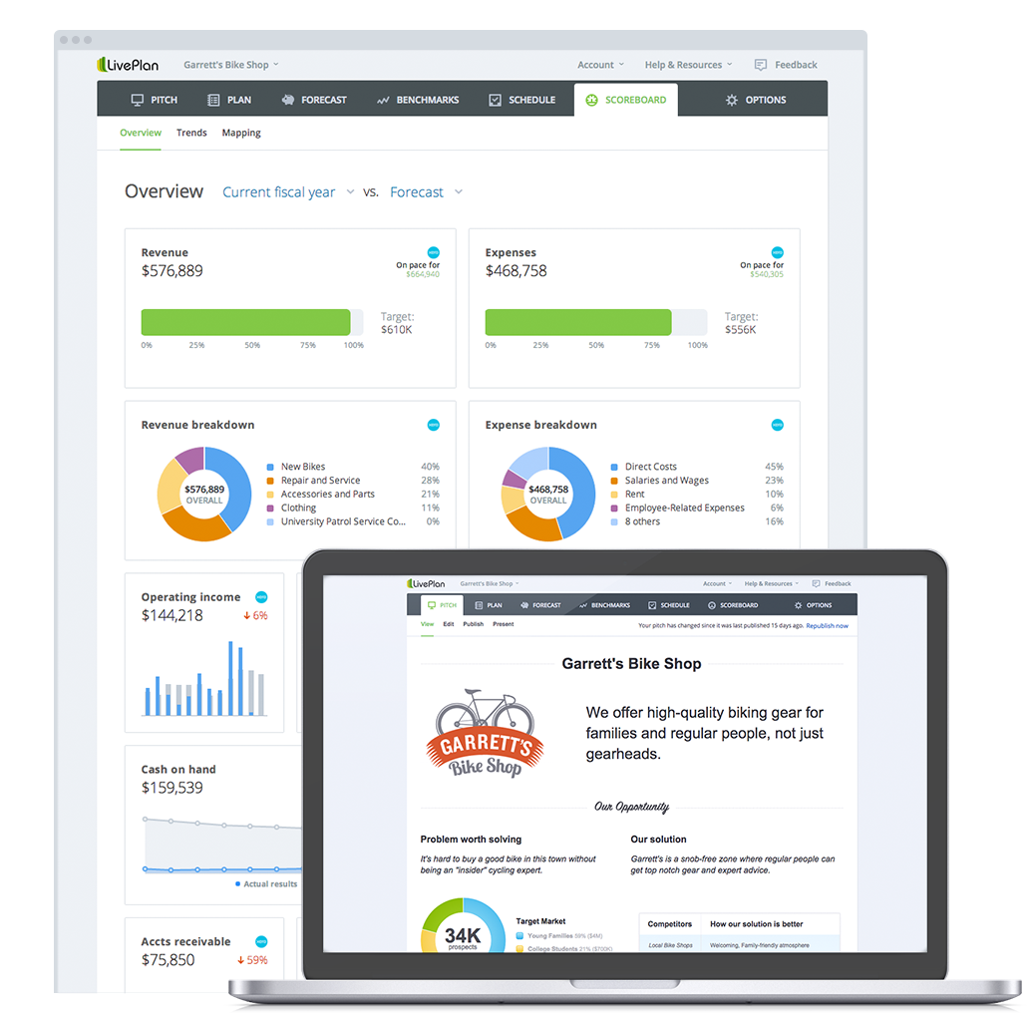
LIVEPLAN OVERVIEW
Who we are
What we do
Increase effectiveness
Improve client engagement
Teach entrepreneurship
Feature tour

Slide 4
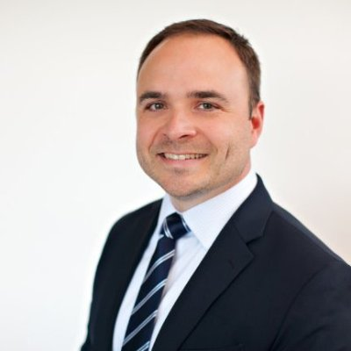
Josh Fegles
Palo Alto SOftware
Experienced working with educators, consultants, and entrepreneurs in the area of business planning, forecasting and management.
Experienced entrepreneur after starting and growing a food production business, Jude’s Foods LLC.
Notes:
Work with Edcuators and Consultants
I’m an entrepreneur too

Slide 5
Who we are
PALO ALTO SOFTWARE MAKER OF LIVEPLAN

Slide 6
Who we are
WE HELP PEOPLE SUCCEED IN BUSINESS

Slide 7
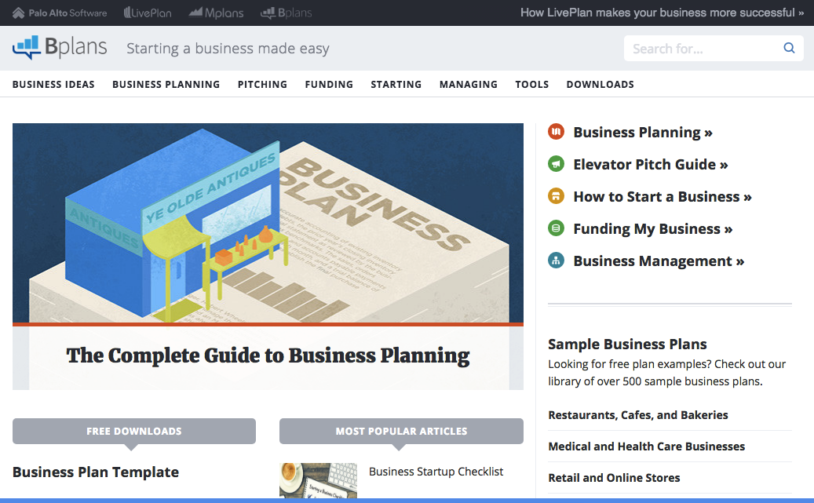
WE HELP PEOPLE SUCCEED IN BUSINESS
Bplans.com
The highest-trafficked business planning site
More than 2MM unique visitors
Top-3 Google organic rank for all "business plan” terms
Notes:
EDUCATION focused

Slide 8
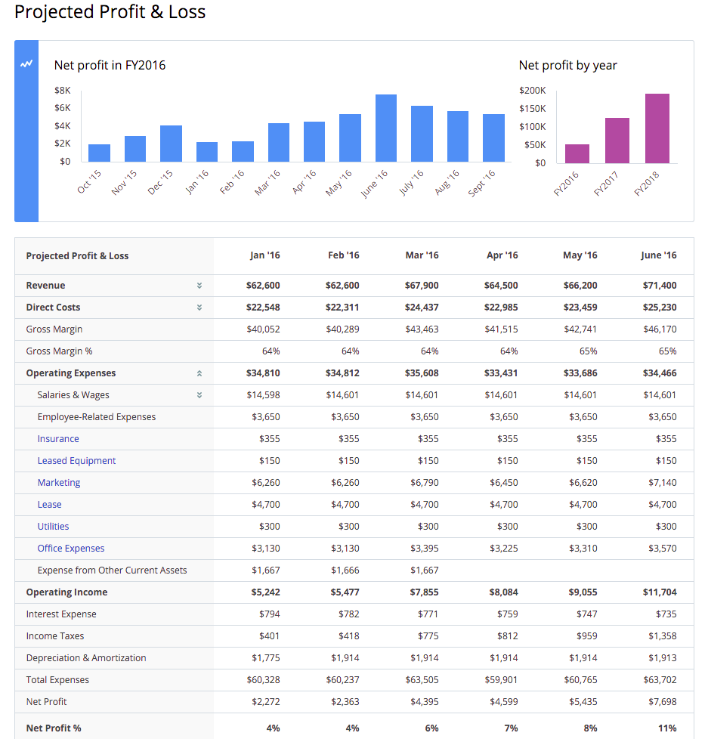
WE HELP PEOPLE SUCCEED IN BUSINESS
By Creating Educational Tools for Entrepreneurs in areas of greatest need.
Business Modeling
Strategic Planning
Entrepreneurial Finance
Growth Management
Notes:
EDUCATION focused

Slide 9
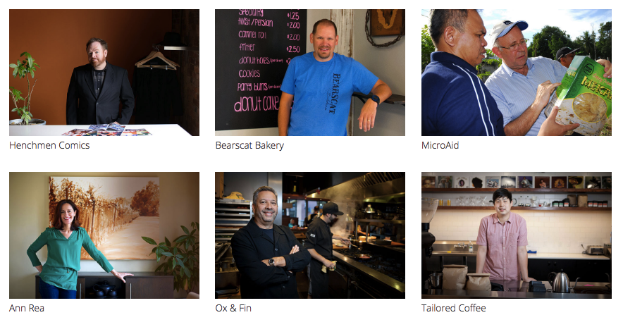
LIVEPLAN FOR TODAY’S ENTREPRENEURS
Used by over 400,000 entrepreneurs worldwide .
Notes:
LivePlan is the most widely used planning and forecasting software used in education.
LivePlan was designed to be educational and instructive.
It is full of resources, examples, searchable FAQ with screen shots.
It is written at a 7th grade reading level to be easy to understand.

Slide 10
LIVEPLAN PROGRAM BENEFITS

Slide 11
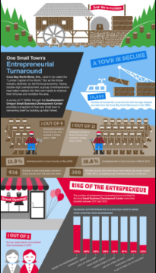
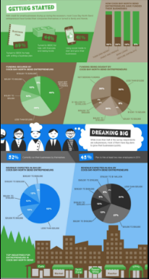
LIVEPLAN
USED BY OR SBDC
Increase your center’s effectiveness!
Arlene Soto, Director of the SBDC in SW Oregon
Arlene’s success includes:
Long-term counseling (5+ hrs) nearly DOUBLED
Online counseling hours more than DOUBLED
Capital infusion TRIPLED
Bank referrals increased

Slide 12
LIVEPLAN
USED BY WWBIC, WBC
Improve client engagement!
Amber Miller, Director of the Women’s Business Center
Amber’s network success includes:
50% increase in student retention rates y/y
Increased overall client engagement
Time building financials decreased 67%
LivePlan students exceed expectations from lenders
Notes:
"We’re having great success with LivePlan not only with completed business plans, but also client/student retention since it’s so user friendly. We normally have about a 30% drop off rate around week 4 of the 8 week series, but now were around 15% drop off rate.
Also, in our traditional business planning series, we normally can spend up to 6hrs on financials (12 month cash flow, start-up and Profit and Loss), but with LivePlan it went down to 2hr of class time---because it’s so easy!"

Slide 13
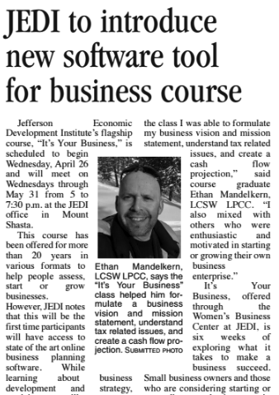
LIVEPLAN
USED BY JEDI, WBC
Teach entrepreneurship!
Nancy Swift, Executive Director of the JEDI WBC
Nancy’s team is using LivePlan to:
Help people start or grow their businesses.
Make it easier for entrepreneurs to forecast financials.
Provide state of the art cloud based software as part of a proven course with over 20 years of success.

Slide 14
LIVEPLAN OVERVIEW

