Slide 1
Changing Face of Business Support
Rani Kroeger,
Uptima Business Bootcamp
For profit / co-op corporate structure where clients are members

Slide 2
CAMEO Annual Meeting June 2017

Slide 3
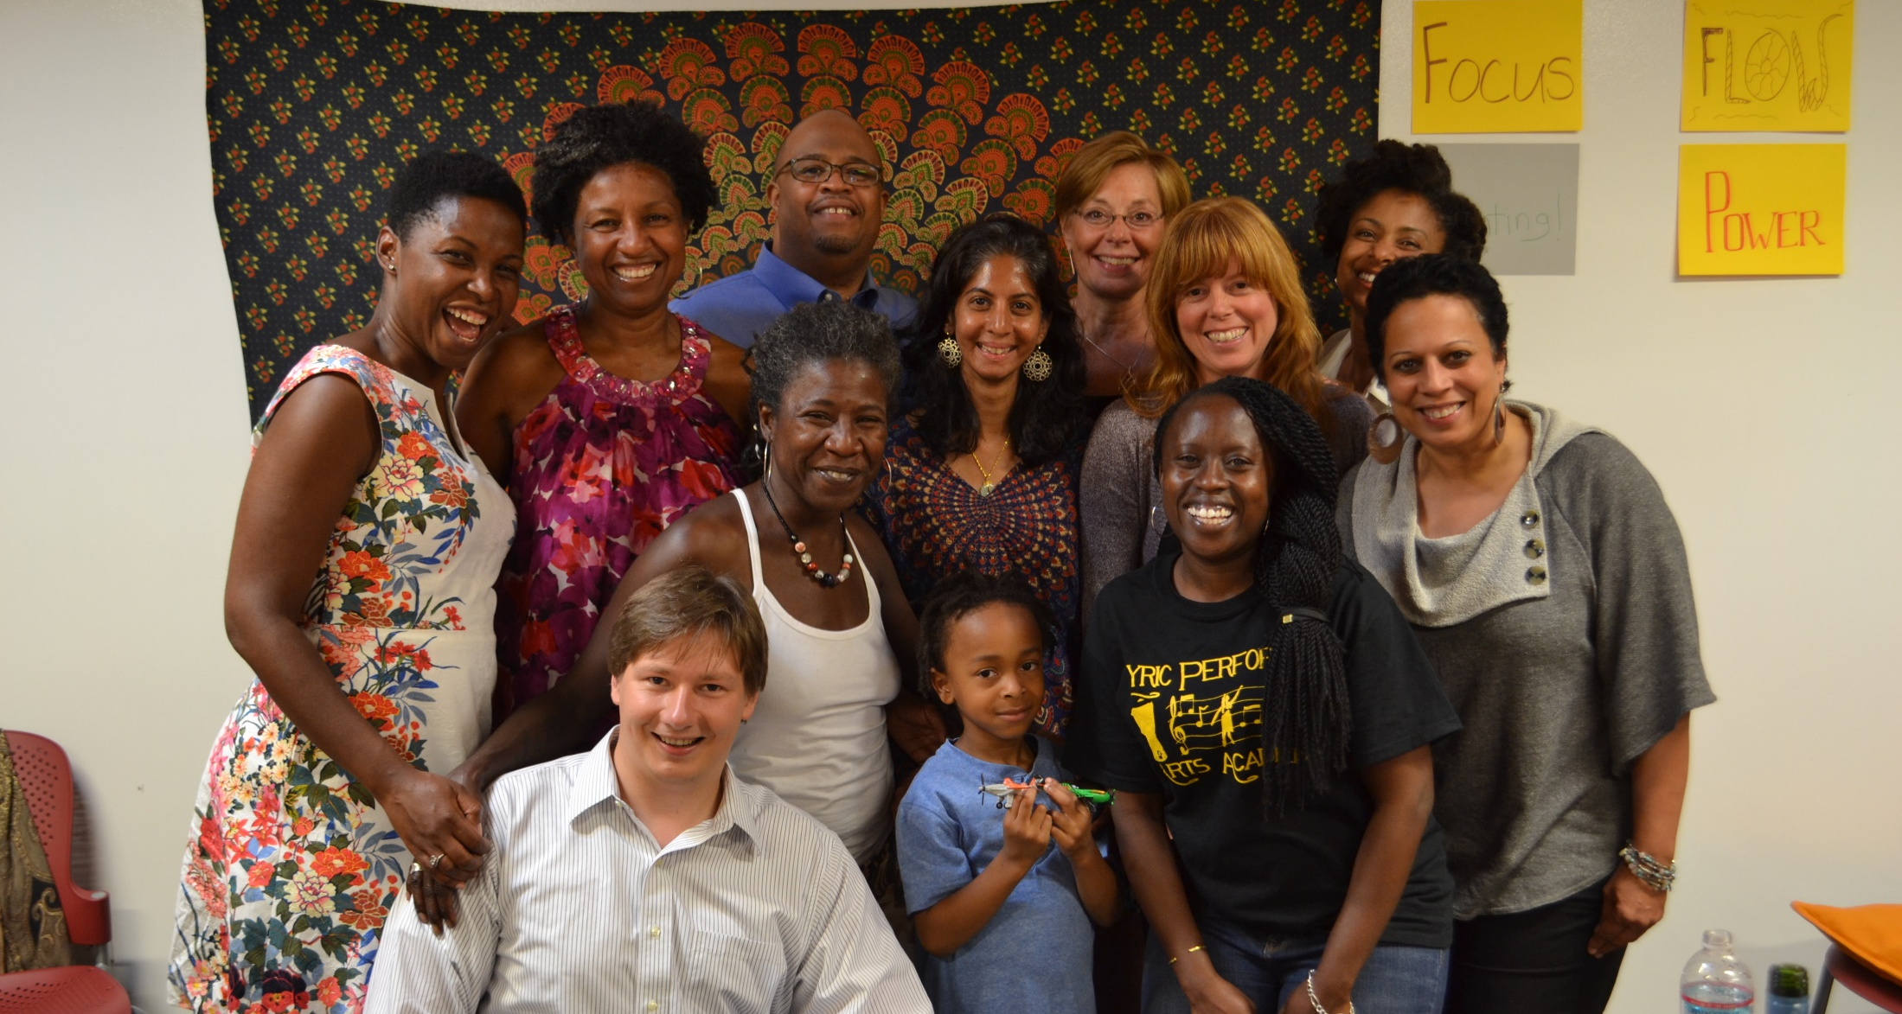
About Us
Uptima Business Bootcamp is a network of member-owned business accelerators, dedicated to providing entrepreneurs with greater access to hands-on education, resources, mentorship and community to create thriving businesses

Slide 4
My Background
Business ownership is a path to wealth creation

Slide 5
Our Network
Oakland
San Francisco
Next City ???
The Uptima network is a system of place-based cooperatives that share the same business model, brand, curriculum and infrastructure

Slide 6
Our Impact
Entrepreneurs Served
Jobs Created
Funding Received
220
56
$238,105
Jobs include paid full-time and part-time employees as well as independent contract work.
Since Uptima started in 2014, we have served over 220 entrepreneurs, who have created 56 jobs and raised over $238,000 in funding

Slide 7
Our Impact
Uptima’s programs serve a diverse group of entrepreneurs

Slide 8
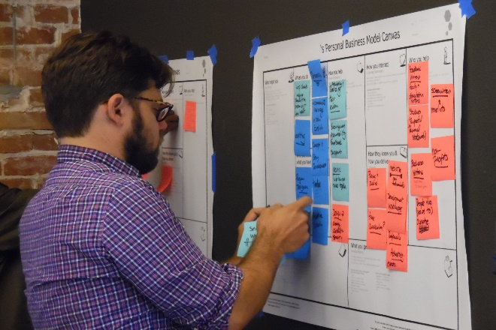
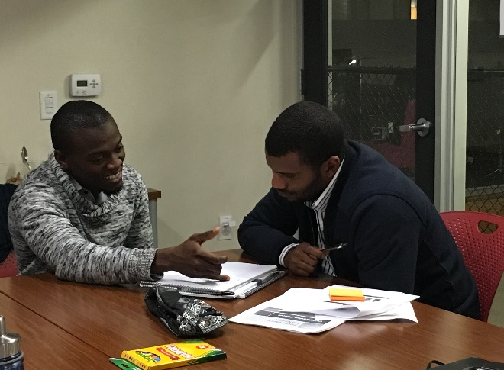
Our Accelerator Programs
Freelancer Program
Small Business & Enterprise Program
Business Advising
Designed for individuals seeking to be their own bosses
6-week program to support economic sustainability as an independent worker
Designed for small business owners and startup founders
Four 12-week modules to support launching, business planning, building operational capacity and funding
Designed for entrepreneurs who are on a faster track or need specific coaching
Customized hourly mentoring sessions to meet their specific business needs
Our accelerators provide education, resources and mentorship to freelancers, small business owners and startup founders in developing their businesses

Slide 9
Our Accelerator Design
Holistic Thinking
Cooperative Network
Hybrid Learning
Community Network Effect
Our flexible programs meet entrepreneurs where they are at and encourage them to think holistically about developing their businesses

Slide 10
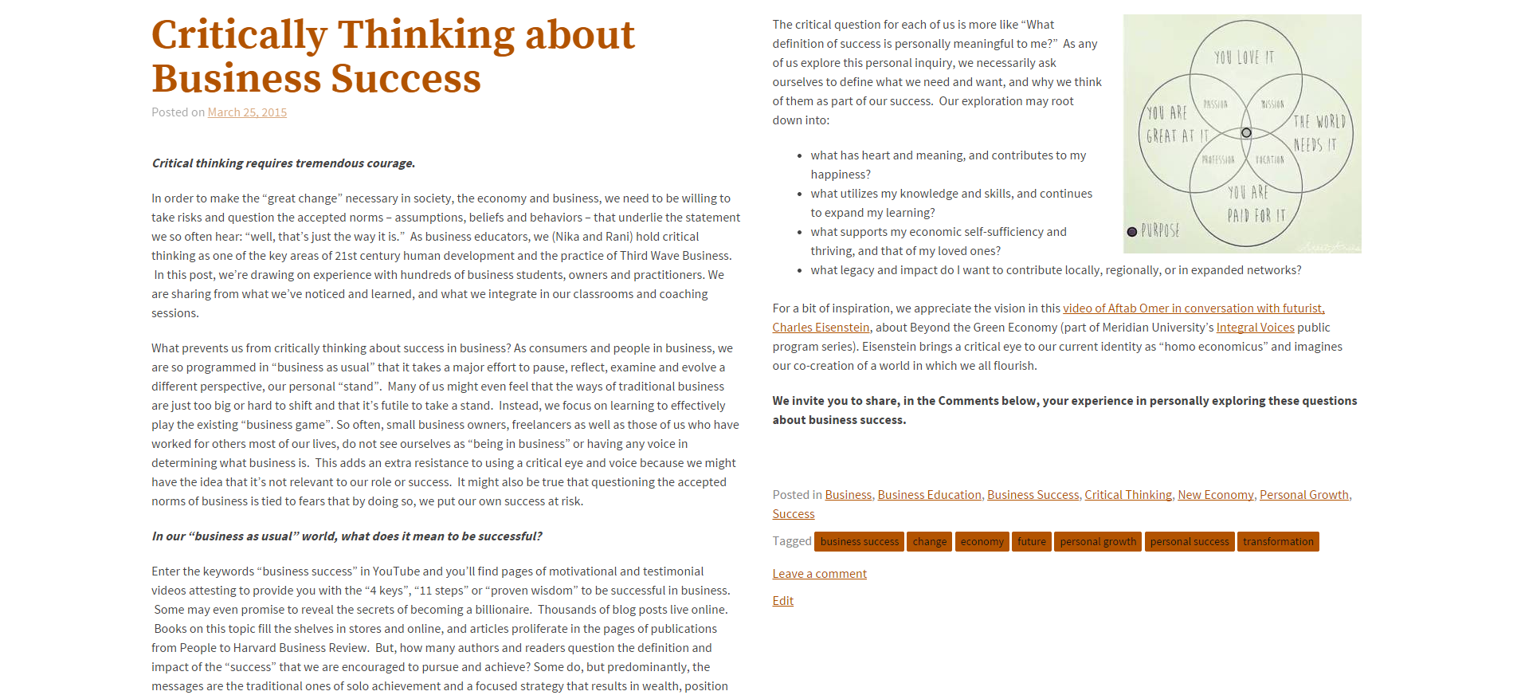
Holistic Thinking: Business Success
Our programs encourage entrepreneurs to think critically about “business as usual”, exploring what it means to be successful in business, how their business fits into their lifestyle and what positive community impact they want to make with their business

Slide 11
Holistic Thinking: Lean Systems
Systems thinking is at the foundation of all of our curriculum and is complemented by design thinking, lean startup and data-driven decision making methodologies

Slide 12
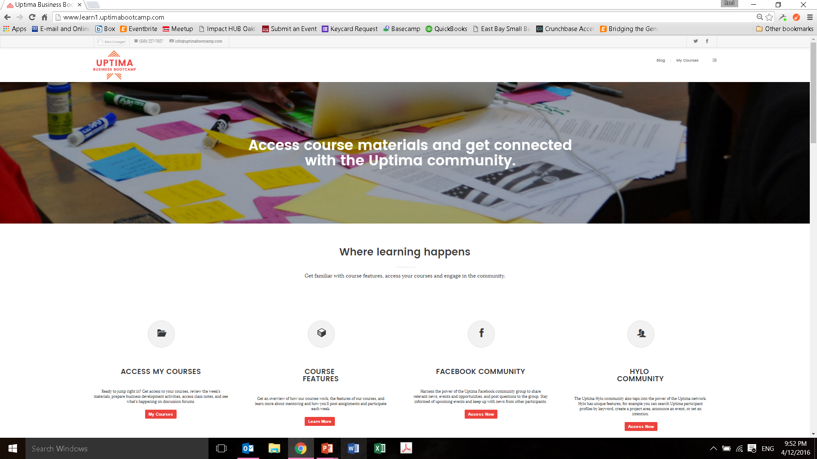
Hybrid Learning: Online Learning
Online learning allows entrepreneurs to review weekly background materials and complete business development activities at their convenience

Slide 13
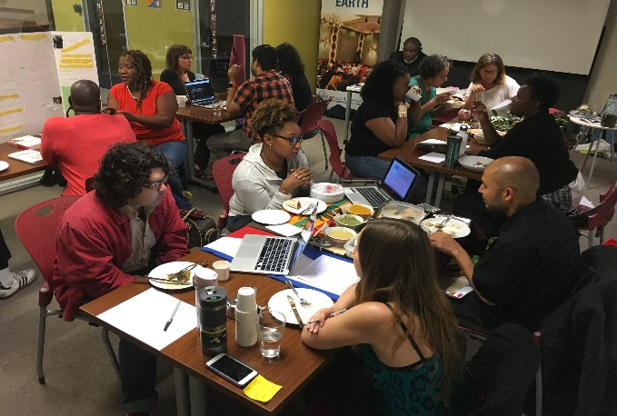
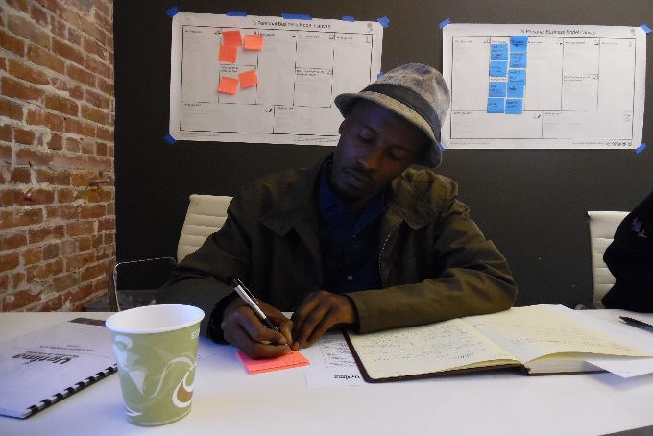
Hybrid Learning: In-Person Classes
Weekly in-person classes consist of mindfulness exercises, group discussion, creative activities and reflection on each unit’s topics

Slide 14
Community Network Effect
Our power is in our community network effect – how we connect business owners with a diverse community of mentors, freelancers, founders and partner organizations who will support them throughout their entire entrepreneurial journey

Slide 15
Cooperative Membership
Our biggest innovation is our business model – each accelerator is a multi-stakeholder cooperative comprised of accelerator program members, worker members and the Uptima network

Slide 16
Accelerator Operating Costs
Program costs – 70% Admin costs – 30%
Receives most marketing, technology and administrative services through Uptima Network
Democratic structure of cooperative provides flexibility in administrative staffing – only part-time support is needed to run accelerator
At steady state, our member fees cover the operating costs of our high-touch programs

Slide 17
Accelerator Equity Pool
Small Business & Enterprise Program members contribute equity stakes in their business that go into an fund, where annual gains are shared among members
Profit Sharing Assuming $10,000 in Annual Gains
 | Total Distribution | # of Members | Distribution / Member
Retained in Cooperative | $1,000
Small Business Members | $6,500 | 10 | $650
Worker Members | $2,000 | 8 | $250
Uptima Network | $500 | 1 | $500
And through the equity pool, members have a long-term investment in each other’s businesses

Slide 18
Cooperative Economics in Action
Elevated Nutrition receives clients through the Uptima Network:
Caters for our Oakland Accelerator classes
Provides meal prep services to busy entrepreneurs
Referrals to cater local conferences and events
Small Business
Small Business
Collects and composts Elevated Nutrition’s food scraps back into the soil for urban gardens
Works with Elevated Nutrition to deliver meals to clients
Freelancer
Provided web design and development services to rebuild Elevated Nutrition’s website
Our structure incentivizes accelerator participants to build a real community that supports each other in creating thriving businesses

Slide 19
Thank you!
Uptima Network: http://uptimabootcamp.com
Oakland Accelerator: http://oakland.uptimabootcamp.com
San Francisco Accelerator: http://sf.uptimabootcamp.com
Our Blog: http://blog.uptimabootcamp.com

