Slide 1

Changing Face of
Business Support
Daniel Fernandez,
Opportunity Fund
Online community lending

Slide 2
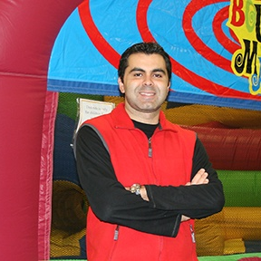
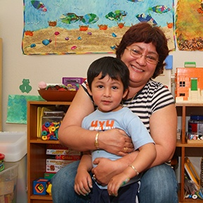
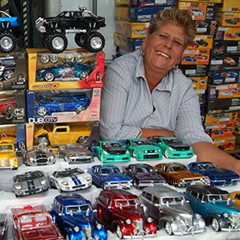
Community Partners Program

Slide 3
Opportunity Fund
Small Business Program
$250K
2,200+
Leading CA nonprofit CDFI micro-lender
Max loan
size in CA
In responsible, alternative financing to underserved small businesses
$60M/yr
98.5%
Run rate
Repayment rate
Offices in SF, LA, San Jose
Notes:
Opportunity Fund helps underserved California small business owners grow by providing responsible alternative financing. We are a leading nonprofit CDFI with offices in San Francisco and Los Angeles, and our headquarters is in San Jose. By the numbers, we lent over $115M last year, with an annual run rate of over $ 50M. Our current portfolio is just over $50M. And, we have a very low 1% default rate. Our mission is to advance the economic well-being of working people by helping them earn, save and invest in their future.

Slide 4
Community Partners
Opportunity Fund helps our California community partners by providing easy-to-get, fast and affordable prime-rate working capital loans
Like Minded
Accessible
Responsive
Trustworthy
- We are an organization with a mission to help our clients succeed
- We support entrepreneurs with our Small Business lending program
- We have helped small business owners for over 20 years
- Thousands of loans made and valued over $100 MM
- Loans from $2.6K - $100K for working capital, equipment, vehicles, and more
- Basic documentation required: bank statements, personal ID
- Qualify: 1 year in business, no credit OK, on-time credit payment history, and no liens or delinquencies
- Fast funding: 2 days for loans under $10K; 5 days for larger loans
- Prequalification rate: 30% for most borrowers
- Approval rate: 90% for most borrowers
- Thousands of loans made and valued over $100 MM
Rapid follow up with your customer
Partnership with you and your customer: we keep you informed of your customer’s loan application from submit to close
Automatic credit reporting so borrowers in good standing will build good credit history
Help borrowers graduate to bank financing
- We share our credit box up front
- Up front and easy to understand rates
- Original Borrower Bill of Rights signatory protects small business owners
- 180 loans valued at $5MM funded each month
- A nonprofit CDFI lending to small businesses in CA for over 20 years
- Largest CDFI in the U.S.
- Local teams in SJ, SF, and LA
- Funded and backed by reputable companies and partners like Wells Fargo, B of A, and Lending Club
- Financed by U.S. Small Business Administration

Slide 5
Community Partner Program
Feature | Benefit
Partners receive 5% partner payment for any loan amount | Generate incremental revenue to support your programs
Minimum documentation requirements | Easy to help clients apply; our clients get funds when they need them
Responsive and dedicated OF staff | Get questions answered quickly, keeping you and your clients updated
Transparent qualification checklist | Easy to determine who to refer, increasing loan approval rates for your clients
Training support | Helps determine who to refer, so more of your clients get approved
Marketing support including co-branded or white-label collateral | Helps you market and sell more effectively, winning more deals
Notes:
We provide you with a qualification checklist so you can easily determine who to refer and more of your clients are approved.
There are minimum documentation requirements so you/your client can easily qualify. We have a dedicated and responsive staff so your clients can get funds in as soon as two days after approval.
OF staff keeps you and your client up to date through the loan process.
For every booked loan, OF will pay a 5% referral fee. Your org earns incremental revenue to fund your programs.
We offer training so you learn who to refer and more of your clients are approved. We provide sales and marketing support: Sales tools like referral guides, document checklists, and marketing support like co-branded marketing materials.

Slide 6
Community Partnership Process
2. Partner Collects documents from client (Checklist)
3. Partners INTROS OppFund to client
(Underwriter)
4.OppFund communicates DECISION to client & Partner
5. OppFund Disburse Funds/Book Loan
1. Partner has INTAKE conversation with client
6. OppFund issues partner payment

Slide 7
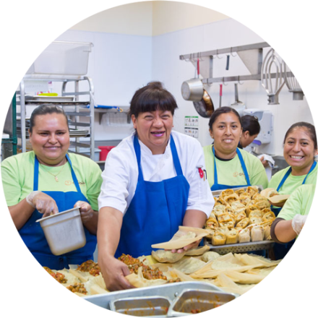
We Help You Refer, Retain & Acquire Clients
REFER
Go-To-Market Marcom Kit:
- Training Content Ex: “How to Prepare for Loan Application
- Marketing Collateral Templates
- Social Media Lending Content, Lending Blog Posts
- Joint Client Story*
RETAIN & ACQUIRE NEW CLIENTS
Refer New Clients:
- Via OF marketing w/ links to your site
- Via OF’s Loan team with warm handoffs to you/your team
CLIENT REFERRAL
Promote Your Program:
- Small Business e-Newsletter
- Small Business Blog
- Small Business Social Media
- Feature Your Program on Borrower Resource Page
*Once a shared client is identified.
Notes:
OF Speaker and Lending content for your training events traditional, web & social media, joint customer success stories.

Slide 8
Co-Marketing Plan
 | REFERRAL Customized Go To Market Kit
Co-Present Lending Content Other Marketing Collateral Product Content Social Media Client Stories | Co-present at Seminars, Workshops – Examples: Lending Options, How to Prepare for Loan Application Provide content for your team to create a video tutorial 1-Pager (EN/SP), Retail Brochure (EN/SP) Link to opportunityfundloan.org (EN/SP) Social media “snippets” re: lending (EN/SP), blog content X-promote on What Our Entrepreneurs Say Share a Joint Success Story

Slide 9
 | RETENTION & ACQUISITION Cross Promote in Opportunity Fund’s Marketing Channels
Small Business E-Newsletter Small Business Blog Small Business Social Media OF Web Site | Include an article on Partner seminar, workshop, networking opportunities Promote Partner in a blog post, events whenever scheduled and on Twitter/FB Promote Partner’s program on our Borrower Resource Page

Slide 10



How does the Small Business Community Partner Co-Marketing Program work?
Dedicated Marketer
Once MOU is signed, a dedicated marketing manager with 7 years+ B2B experience who is supported by OF’s SB Marketing team.
Joint Plan
We’ll work with your team member(s) to create a joint execution plan with estimated time to complete.
Phased Execution
We’ll use a phased approach to help you successfully start referring and retaining clients.

Slide 11
The Microloan Solution
 | Express Loan For clients establishing or re-establishing credit | Micro/SB Loan For clients needing MCA refinancing or Working Capital | Commercial Vehicles For mobile food or other commercial vehicles
Loan amount Term No credit Documentation Get cash in as few as Pre-payment penalty Hidden fees Interest rate | < $10K < 2 years OK Minimum 2 days No No* Fixed, starting at 12% | < $50K < 4 years OK Basic 5 days No No* Fixed, starting at 8.5% | < $100K < 5 years OK Basic 5 days** No No* Starting at 9.5%
* No prepayment penalties, no application fees, no hidden fees. **Once vehicle is identified.
Notes:
Our Express loan is one of the easiest and fasted loan to provide your clients. Up to $10,000 and very little documentation is needed. Only personal ID and some proof of business. No credit is required. And, clients can get cash in as little as two days.
For clients needing MCA refinancing or a pay-as-you go option, our Easy Pay Loan is a good choice. Up to $ 50,000 for up to 4 years. Only basic documentation is required and no credit is OK. Clients get cash in as little as 5 days on average.
Our Commercial Vehicle loans to purchase mobile food carts, transportation vehicles or other commercial vehicles are available for up to $50K and up to 5-year terms. These affordable loans start at a 9.5% interest rate. Only basic documentation is required and no credit is OK. Clients get cash in as little as 5 days on average.
None of our loans have pre-payment penalties or hidden fees. There is a low-cost loan origination fee that can be financed.

Slide 12
Formalizing our Partnerships
Product, Payment, and Relationship Details
Loan Products
Express ($2.6-$10k)
Micro & Small Business ($2.6-$100k)
Commercial Vehicle
*Introduce “credit builder” concept
Referral Pricing
Booked loans will be paid a 5% referral fee with a floor of $250 and a maximum amount of $2,500
MOU
A signed MOU will serve as a summary of goals and requirements for each partner participating in the program
Training
Outlined in the agreement will be a training on our loan products in order to ensure each partners is familiar and comfortable with our program
Co-Branded Marketing Material
The ability to co-brand marketing collateral will be available in addition to access to our general promotion items
Notes:
Talking points for this slide will also address our strategy (Engage program directors to introduce referral program ,Track partners & activity etc.)

Slide 13
Let’s Work Together
MOU
A signed MOU will outline the goals and requirements for program participation.
Training
We offer training on our program and loan products to ensure you and your team are able to represent this opportunity to your clients.
Marketing
We’ll provide the ability to
co-brand marketing collateral
and make our product collateral available to you.
Notes:
Use slide only when meeting with ED, Program Director at Community Partner organization

