Slide 1
Intro to
QuickBooks Self-Employed
Sponsored by CAMEO-
California Association for
Micro Enterprise Opporunity
Presented by-
Mariette Martinez, EA
@MMartinezEA

Slide 2
Mariette F. Martinez, EA
IRS Enrolled Agent
Certified QuickBooks ProAdvisor since 2007
Worked in the Accounting & Tax Industry for over 20 years
Intuit’s 2015 Top 20 Firm of the Future
Hubdoc’s 2015 & 2016 Top 50 Cloud Accountants
Public Speaker & Educator at various industry conferences
Contributor to Intuit’s TaxProCenter Blog
Twitter: @MMartinezEA
Facebook: marietteinthecloud
Elevator Pitch: I provide consulting services in the areas of accounting technology & project management workflows to small businesses. I love contributing to the Entrepreneur community (especially #Mommypreneurers like ME).
Short History Lesson: In 2010, I opened my sole-owner accounting & tax practice and work with small business owners and solopreneurs. I have worked 100% virtually since I started my company and utilize & train on several of Intuit’s accounting & tax online solutions for my firm.
My Blended Life: I am a busy mom of 3 kids all under 11 & happily married for 13 years. I start every morning with the goal to make a positive difference in someone’s day. I use #SocialMedia to change as many lives as possible.

Slide 3
Polling question 1
Please choose the best option that you identify with:
Small business consultant
Small business bookkeeping professional
Small business owner
Freelancer/1099 contractor

Slide 4
Who, What & Why about Self-Employed
Who are the self-employed
Should Small Business Consultants care about Self-Employed
Which client is RIGHT for QuickBooks Self-Employed
Let’s take a tour into QuickBooks Self-Employed
Is it time to transition to a new Intuit accounting platform
Q&A..I want to hear from you!!!

Slide 5
Pencils ready
Light bulbs turned on
Coffee hot and served
Phones turned off
(or muted)
THEN LET’S GET STARTED!
Smiles big & bright
@MMartinezEA

Slide 6
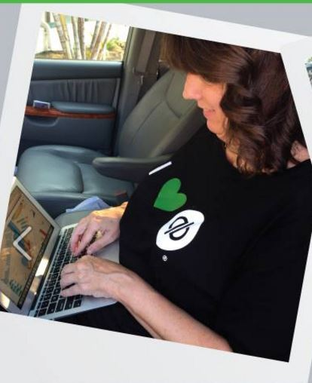
Self-Employed (SE) or Small Business Owner (SBO)?
Does your client look like this?
Or does your client look like that?
@MMartinezEA

Slide 7
Is a Self-Employed Client also a Small Business, too? Heck YES! Then what’s the difference?
Self-Employed work
IN their Small Business
Small Business owners work
ON their Small Business
@MMartinezEA

Slide 8
Other identifiers of Self-Employed
SE perform all tasks vs SBO manage tasks
SE use their time to make money vs SBO build teams to pull in revenue
SE perform ALL client services vs SBO are employers that manage teams
SE can be part-time 1099 contractor + W2 income
SE have minimal overhead vs SBO may require capital to sustain, scale & grow their businesses
SE is a Business of ONE VS SBO has a team of employees
@MMartinezEA

Slide 9
Real-life examples of Self-Employed individuals
Creative: photographer, writer, artist, athlete, Etsy
Personal care: hair dresser, masseuse, manicurist, hygienist
On demand: Lyft, Uber, Task Rabbit
Wellness: nutritionist, personal trainer, medical field
Services: accountant, financial planner, attorney, consultant, realtor, virtual assistant, sales agent, engineers, government contractor
@MMartinezEA

Slide 10
Why is it important to identify a SE vs SBO?
QuickBooks Self-Employed
IS RIGHT for a Self-Employed Solo-Entrepreneur
QuickBooks Self-Employed
IS NOT RIGHT for a Small Business Owner
@MMartinezEA

Slide 11
Should Small Business Consultants care about Self-Employed
Per Bureau of Labor Statistics in 2005
Per U.S. Government Accountability Office Statistics in April 2015
Per Freelancing in America in 2015
Combined total of contingent and alternative workers topped 18 million people, or 13.6% of the labor force.
Results showed that approximately 54 million people did freelance work in 2014.
GAO predicts the percentage of self-employed workers to rise to 50% of the labor force by 2020.
That’s means 60+ million people will be self-employed!
@MMartinezEA

Slide 12
Ok, let’s take a quick breather … or check your breath, your choice!
Any questions?

Slide 13
So WHO is the Right Match for QuickBooks Self-Employed?
@MMartinezEA

Slide 14
What isn’t QuickBooks Self-Employed (QBSE)
QBSE is NOT QuickBooks Online
QBSE is NOT a general ledger accounting system
QBSE is not on accrual basis tax accounting
QBSE does NOT track A/R or A/P
QBSE does NOT track sales taxes as a liability
QBSE does NOT track inventory as an asset
QBSE does NOT include payroll
QBSE does NOT convert/migrate to any other QB Products
@MMartinezEA

Slide 15
What IS QuickBooks Self-Employed (QBSE) (part1)
Year round cash-basis accountability tool for Simple Schedule C taxpayers that encourages and assists in organizing personal and business finance transactions and utilizes one-of-a-kind features such as an integrated quarterly estimated tax calculator and automatic mileage tracking to keep a Schedule C Sole Proprietor in line
@MMartinezEA

Slide 16
What IS QuickBooks Self-Employed (QBSE) (part2)
Or in plain English, a mobile and web-based app that will keep millions of Independent Contractors organized year round with their Self-Employed finances and help them be aware, informed and on top of their personal and Schedule C federal tax obligations.
@MMartinezEA

Slide 17
What DOES QuickBooks Self-Employed do
QBSE banishes the box for Schedule C clients through receipt capture thru mobile & web app
QBSE allows UNLIMITED bank & credit card feed upload so that all Schedule C transactions are in electronic format
QBSE tracks mileage automagically
QBSE creates invoices with e-payment options
QBSE provides federal estimated tax calculations
QBSE provides a Schedule C Profit & Loss report
QBSE provides exportable transaction reports for tax return analysis
QBSE allows Accountant and SE user collaboration (both ways) through the QuickBooks Online Accountant integration
Want to get MORE EXCITED: Read my BWAM blog on how QBSE has grown in just 2 years:
BWAM article QuickBooks Self-Employed Then & Now
@MMartinezEA

Slide 18
Polling question 2
What % of your clients are Simple Schedule C clients that would be a good fit for QuickBooks Self-Employed
0%–25%
26%–50%
51%–75%
76%–100%

Slide 19
Any questions?

Slide 20
Let’s take a tour
of QBSE from within QBOA!
Test Drive later yourself!
Check out my YT channel for QuickBooks Self-Employed here!
@MMartinezEA

Slide 21
Is it time to transition to a new Intuit accounting platform?
Does your client look like this?
Or does your client look like that?
@MMartinezEA

Slide 22
Let’s break it down…
QuickBooks Self-Employed
Specifically designed for independent contractors and freelancers: Form1099 MISC
Calculates quarterly taxes and tracks mileage automatically
Cash Basis accountability tool ONLY: NOT for a Small Business Owner or Employer
QuickBooks Online Simple Start
1 User + 2 Accountants
Bank feeds, invoices, sales taxes, 20 reports but NO Accounts Payable
QuickBooks Online Essentials (Simple Start + …..)
3 Users + 2 Accountants
Accounts payable, MORE financial reports but NO inventory tracking
QuickBooks Online Plus – This is PowerHouse of QB Online
5 Users + 2 Accountants WITH option to Add More; Unlimited Time Tracking ONLY users
Purchase Orders, FIFO Inventory Tracking and CLASS/DEPARTMENT Tracking, Budgets

Slide 23
Bonus Slides!!!
Deep Dive into
QuickBooks Self-Employed Chart & Invite Your Accountant
@MMartinezEA

Slide 24
Deep dive tour into QuickBooks Self-Employed – Part 1
 | Basic Features | Advanced Features
Screen
Home | Invite an accountant Easy income/expense + spending visibility Review account balances Task reminders Direct links to open tasks | Utilize P&L graphic chart Comparative time frame views of P&L chart NEXT est tax due (near gear icon) Gear account settings Toolbox in navigation
Transactions | Connect banks & CC Review new transactions Attach receipts (esp. easy on mobile) Add notes | Add purpose to business/personal items Split transactions Import transactions Create/ manage rules Review “filter” & “search” options
Miles | Automatic mileage tracking via mobile “Old school” add trip manually | Review mileage against calendar Decide on actual vs mileage deduction
@MMartinezEA

Slide 25
Deep dive tour into QuickBooks Self-Employed – Part 2
 | Basic Features | Advanced Features
Screen
Taxes Quarterly Taxes: Annual Taxes: | Quarterly tax estimates and reminders Print estimated tax voucher Setup tax profile Review comparisons/options of SchC deductions | Tax projections Deep Dive into Annual taxes categories: Standard vs. actual method (miles and home office) Assets vs expenses Health insurance premium deduction
Reports | P&L Tax summary Tax Details | Export Tax details for analysis of: business income and expenses, split by quarter and SchC categories – great for advanced tax planning, tax prep & Form 1099 prep
Invoices | Lightweight, professional invoicing On-the-go invoicing with the mobile app Bill by hour, per item or flat rate Easy re-send and tracking of invoicing | Clients can customize and add a logo Connect online payments (w/ QB Payments) to get paid faster
@MMartinezEA

Slide 26
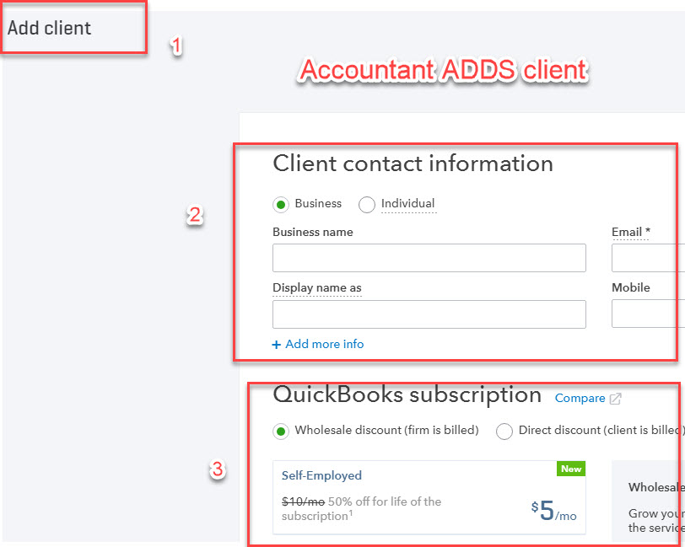
QuickBooks Online Accountant collaboration in 3 easy steps…(P1)
Accountant ADDS the Client
Tip: Client can pay $4/month for first year and then transition to $5/month on wholesale

Slide 27
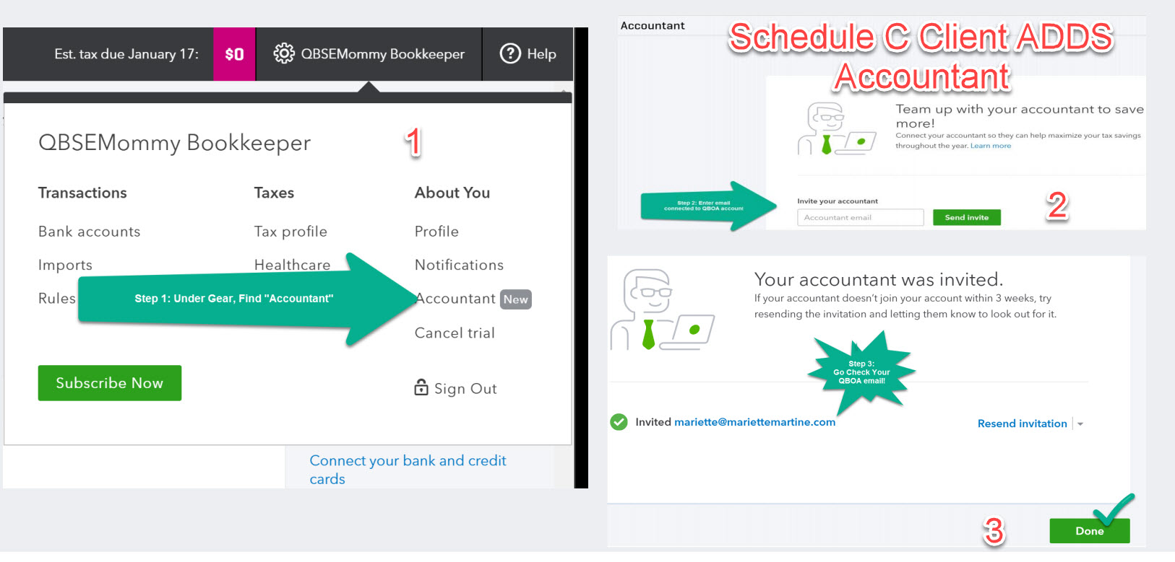
QuickBooks Online Accountant collaboration in 3 easy steps…(P2)
Client ADDS the Accountant
Tip: Confirm you provide client with correct QBOA EMAIL account if you manage multiple QBOA accounts

Slide 28
Questions??
@MMartinezEA

