Slide 1
The Entrepreneurial Ecosystem: Coaching

Slide 2
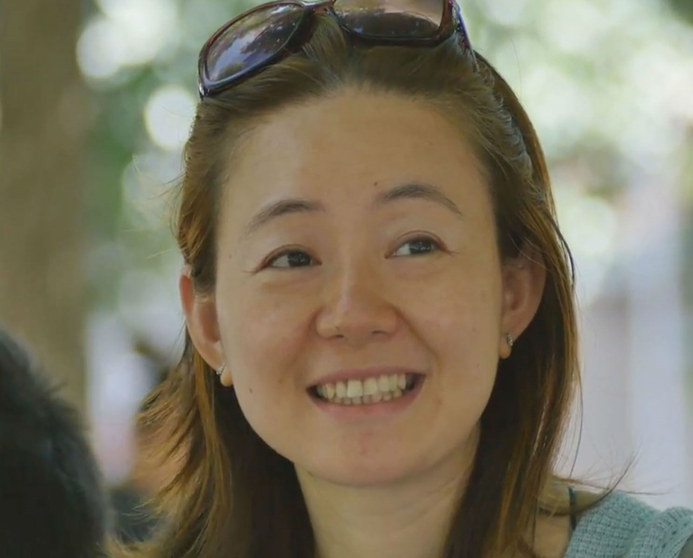
Anna
Motivated
P.S.
$8 / hour
Unemployed
Food stamps

Slide 6
$25 / HOUR

Slide 7
WORKFORCE
DEVELOPMENT

Slide 8
CVs
COVER LETTERS
INTERVIEWS
JOB SEARCH

Slide 9
$
$
$
$
$
$
$
$
$
$
$
$
$
$
$
$
$
$
$
$
$
$
$
$
$
$
$
$
$
$
$
9-5
$
$
$
$
$
$
$
$
$
$
$
$
$
$
$
$
$
$
$
$
$
$
$
$
$
$
$
$
$
$
$
$
$
$
$
$
$
$
$
$
$
$
$
$
$
$
$
$
$
$
$
$
$
$
$
$
$

Slide 10
SMALL BUSINESS
DEVELOPMENT

Slide 11
…SELF-IDENTIFIED ENTREPRENUERS

Slide 12
GIG ECONOMY
=
ON-RAMP TO WORK?

Slide 13
DEMONSTRATE SKILLS
BUILD DIGITAL CV
REFERENCES

Slide 14
LOWER BARRIER TO ENTRY
RAPID ACCESS TO JOBS
LIVING WAGE

Slide 15
59%

Slide 16
ENTREPRENUERIAL
SKILLS

Slide 17
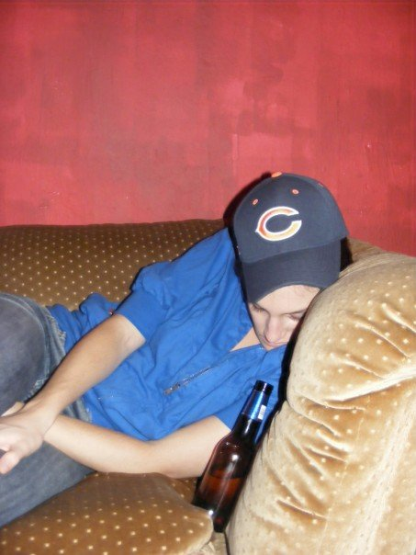
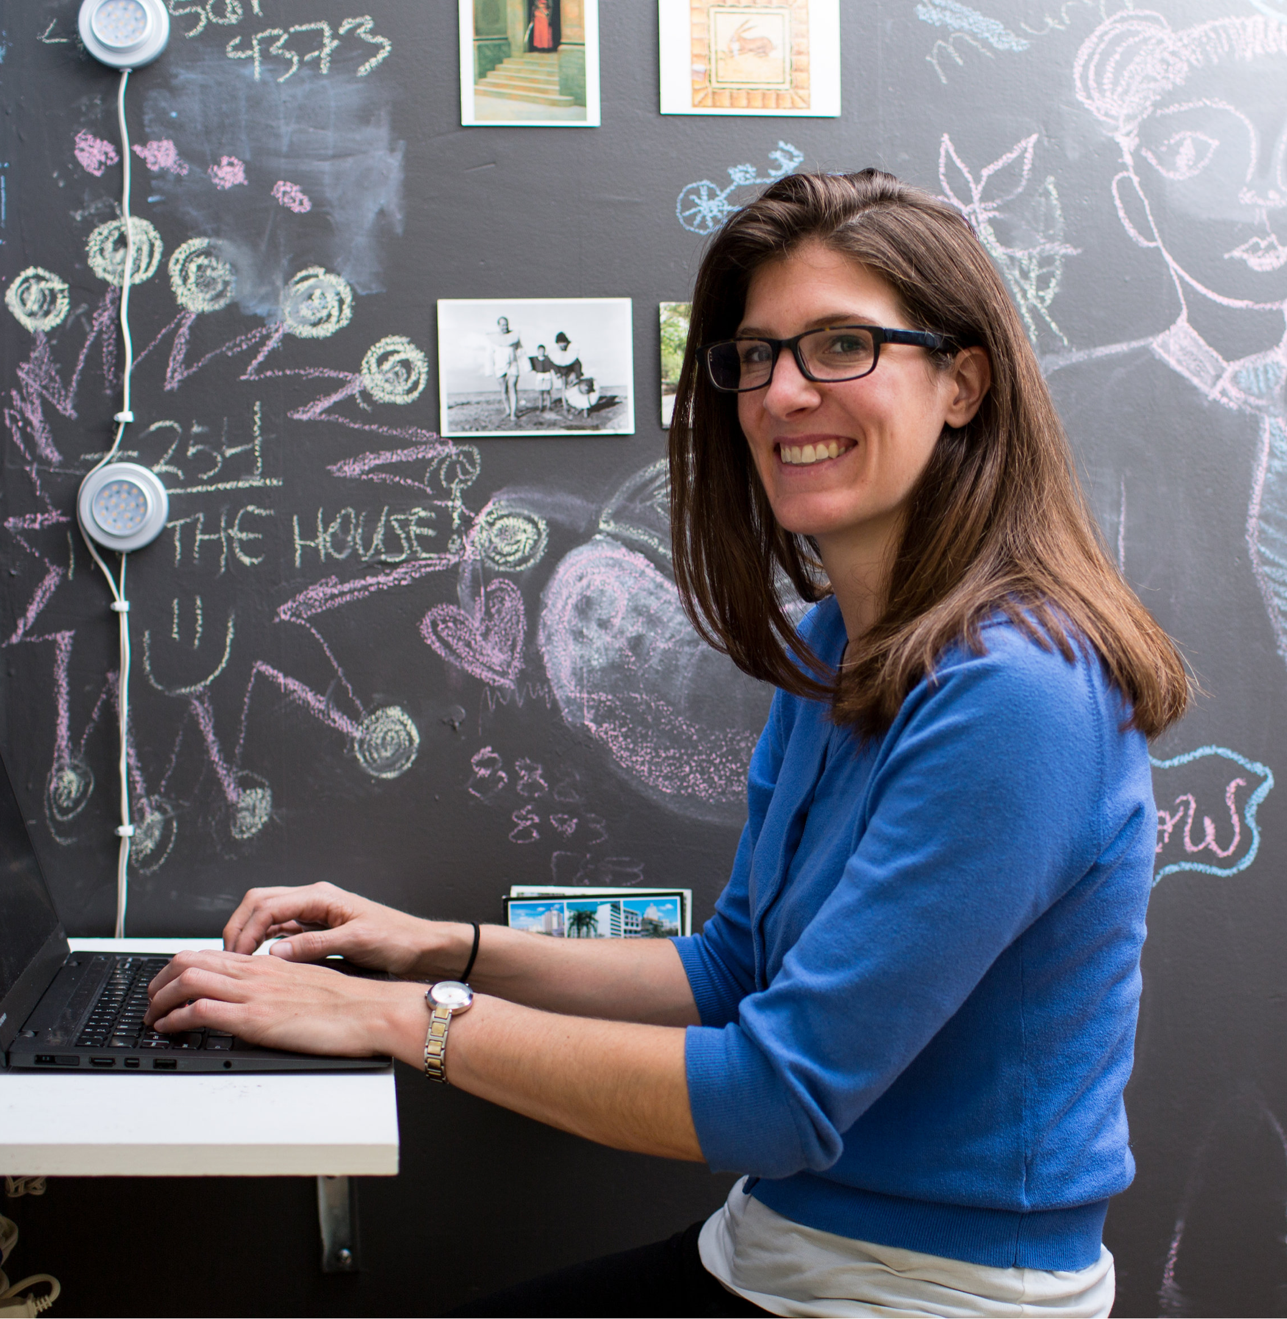

Slide 18
HI JOHN,
I HAVE SIX YEARS OF PROFESSIONAL CLEANING EXPERIENCE. I AM THOROUGH, SPEEDY, AND I LOVE MY WORK!
- ANNA
HI,
I’M INTERESTED IN THIS JOB. I HAVE LOTS OF EXPERIENCE.
- ANNA

Slide 19
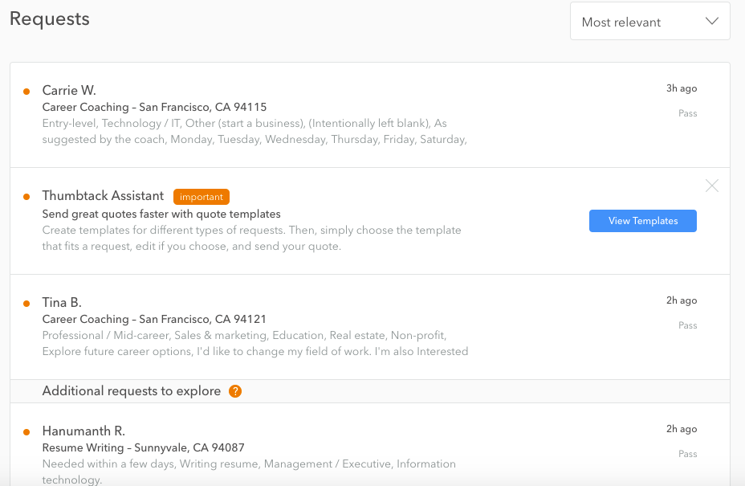

Slide 20
TRAINING (AND FUNDING) FOR TODAY’S WORKFORCE

