Slide 1
CAMEO:
New Era Workforce Symposium
January 18, 2017

Slide 2
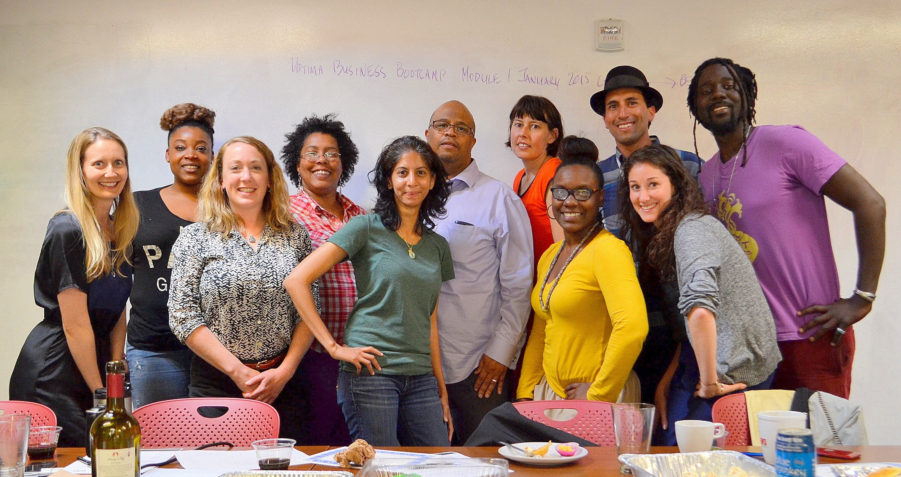
About Us
Uptima Business Bootcamp is a network of member-owned business accelerators, dedicated to providing entrepreneurs with greater access to hands-on education, resources, mentorship and community to create thriving businesses

Slide 3
My Background
Entrepreneurship is a path to wealth creation

Slide 4
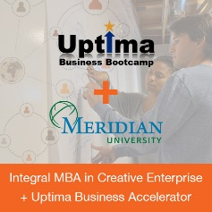
Our Evolution
Announced Joint MBA + Accelerator Program
Launched out of
Oakland business accelerator officially became a California Cooperative Corporation
2014
2015
2016
Piloted Oakland Small Business & Enterprise Accelerator
Received 30 applications for first cohort of 9 entrepreneurs
Piloted Freelancer Accelerator
Graduated 40 entrepreneurs from Oakland accelerator programs
Served 220 entrepreneurs to date
Uptima was started out of Impact HUB Oakland in early 2014

Slide 5
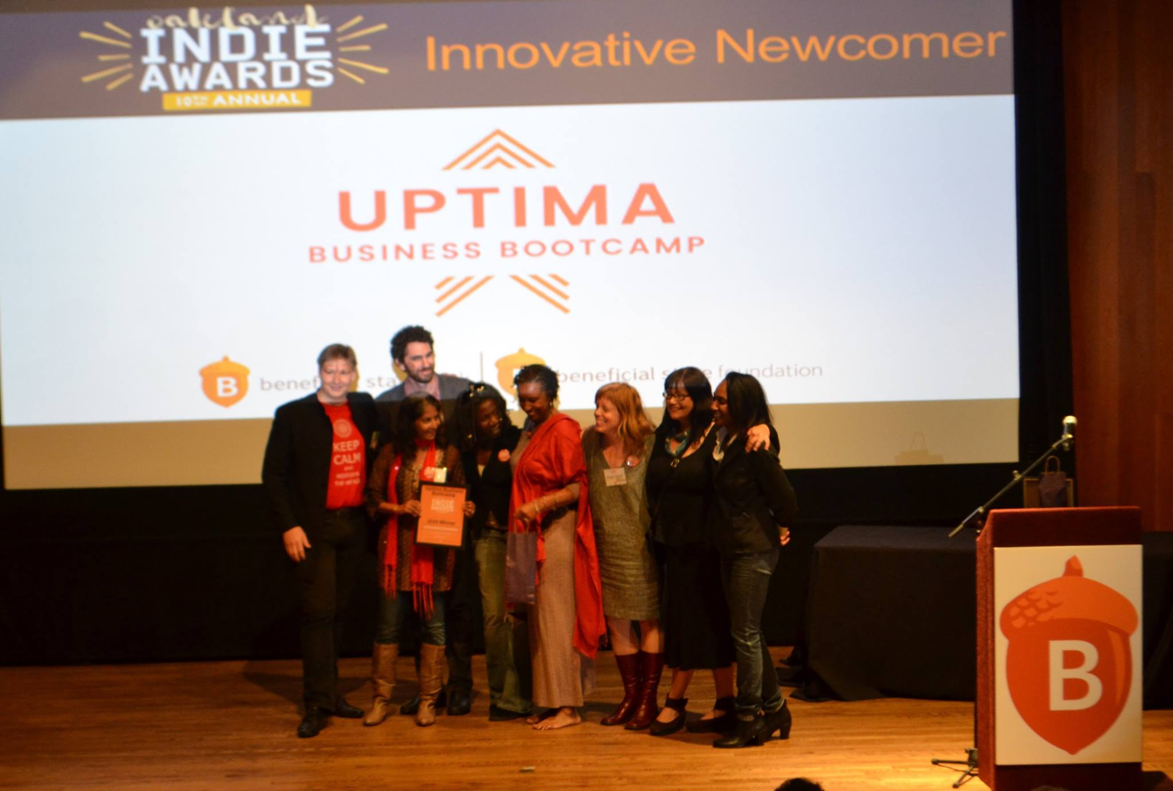
Award Winning
In 2016, Uptima was recognized as Innovative Newcomer at the Oakland Indie Awards

Slide 6
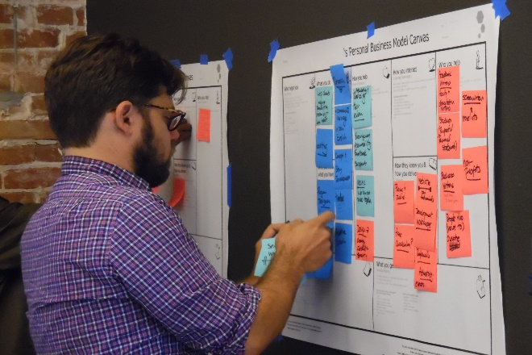
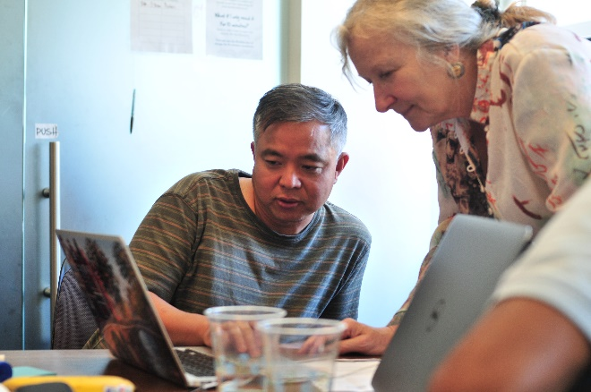
Our Accelerator Programs
Freelancer Accelerator
Small Business & Enterprise Accelerator
Business Advising
Designed for individuals seeking to be their own bosses
6-week program to support economic sustainability as an independent worker
Designed for small business owners and social entrepreneurs
Four 12-week modules to support launching, business planning, building operational capacity and funding
Designed for entrepreneurs who are on a faster track or need specific coaching
Customized hourly mentoring sessions to meet their specific business needs
Our accelerators provide education, resources and mentorship to freelancers, small business owners and social entrepreneurs in developing their businesses

Slide 7
Our Accelerator Design
Holistic Thinking
Community Network Effect
Hybrid Learning
Cooperative Membership
Our flexible programs meet entrepreneurs where they are at and encourage them to think holistically about developing their businesses

Slide 8
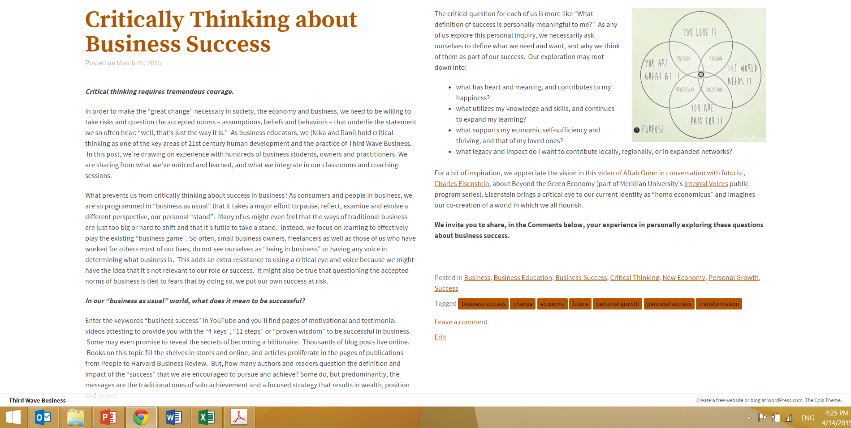
Holistic Thinking: Business Success
Our programs encourage entrepreneurs to think critically about “business as usual”, exploring what it means to be successful in business and how we can co-create a world in which we can all flourish

Slide 9
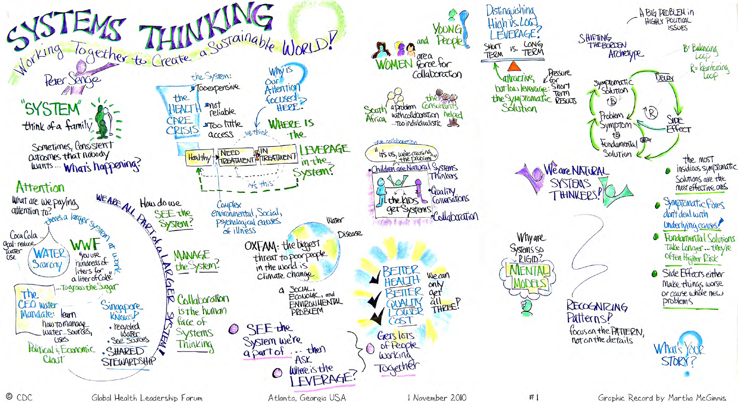
Holistic Thinking: Lean Systems
Systems thinking is at the foundation of all of our curriculum and is complemented by design thinking, lean startup and data-driven decision making methodologies

Slide 10
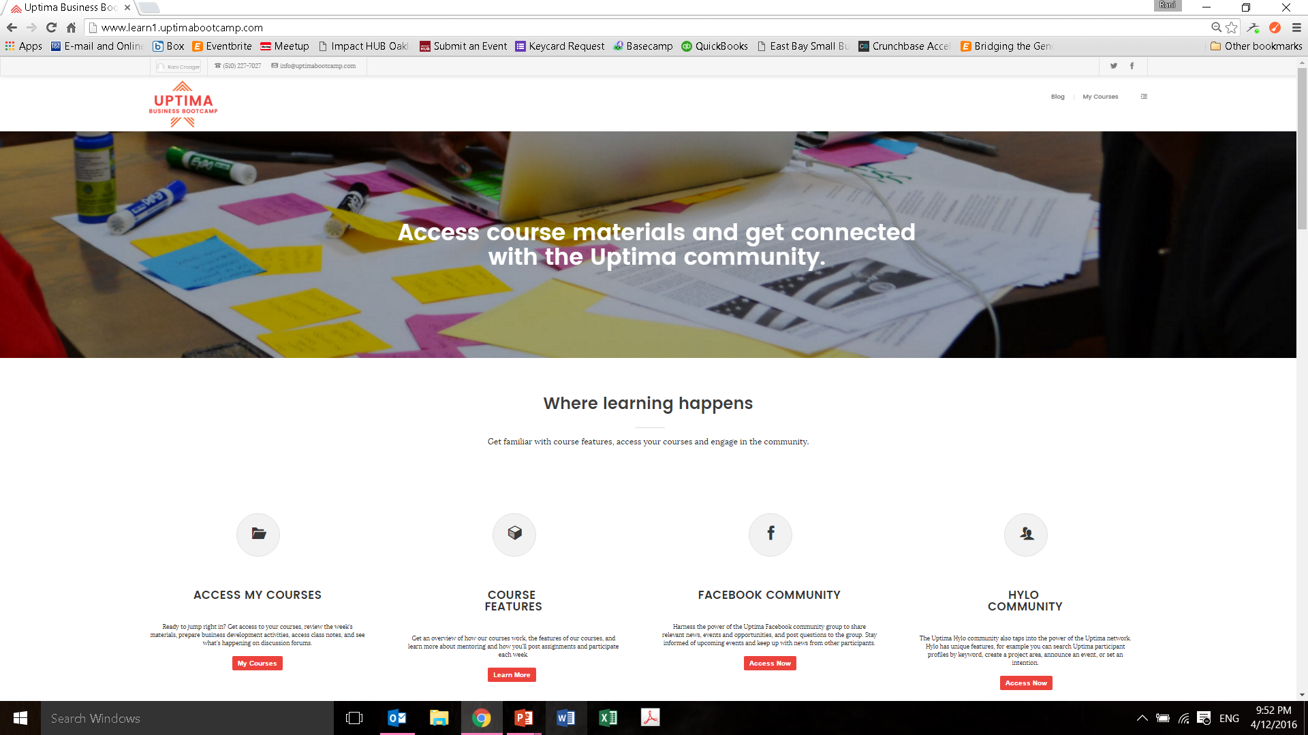
Hybrid Learning: Online
Online learning allows entrepreneurs to review weekly background materials and complete business development activities at their convenience

Slide 11
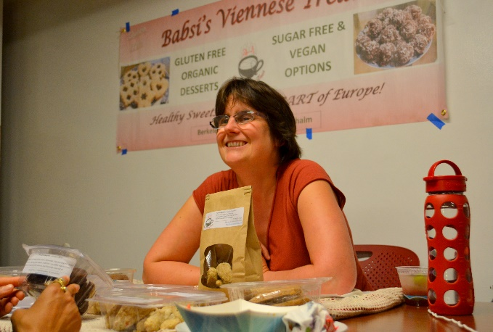
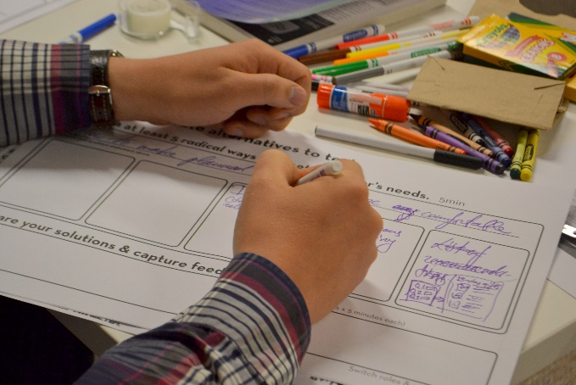
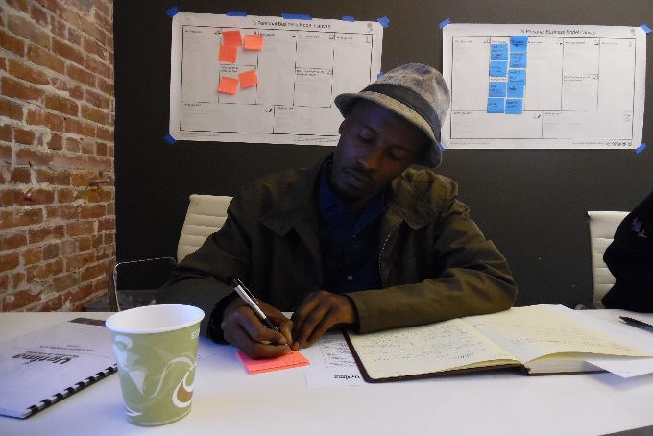
Hybrid Learning: In-Person Classes
Weekly in-person classes consist of mindfulness exercises, group discussion, creative activities and reflection on each unit’s topics

Slide 12
Cooperative Membership
Each of our accelerators is a multi-stakeholder cooperative comprised of worker members, accelerator program members and investor members

Slide 13
Cooperative Membership
Small Business & Enterprise Accelerator Membership
Freelancer Accelerator Membership
< $100,000 Annual Revenue | $100,000 - $500,000 Annual Revenue | > $500,000 Annual Revenue
$300 / month cash fee | $400 / month cash fee | $500 / month cash fee
5.0% one-time equity stake contribution | 4.0% one-time equity stake contribution | 3.0% one-time equity stake contribution
< $50,000 Annual Revenue | $50,000 - $100,000 Annual Revenue | > $100,000 Annual Revenue
$450 cash fee | $600 cash fee | $750 cash fee
We keep our accelerator membership accessible by offering a sliding scale fee structure based on the current annual revenue of the business

Slide 14
Community Network Effect
Our power is in the community network effect – how we connect business owners with a diverse community of mentors, freelancers, founders and partner organizations who will support them throughout their entire entrepreneurial journey

Slide 15
Our Impact
Entrepreneurs Served
Jobs Created
Funding Received
220
56
$228,105
Since Uptima started, we have served 220 entrepreneurs, who have created 56 jobs and raised over $228,000 in funding

Slide 16
Our Impact
Uptima’s programs serve a diverse group of entrepreneurs

Slide 17
Runway Project Partnership
Recently announced a partnership with Runway Project, Impact HUB Oakland and Self-Help Federal Credit Union to pilot a Friends & Family Loan Program for African-American entrepreneurs in Oakland

Slide 18
Our Expansion
Licenses intellectual property of accelerator model
Service agreement to provide infrastructure to each cooperative
Longer term conversion to shared services cooperative and franchise
Uptima Business Bootcamp, LLC
Uptima Oakland Cooperative
Uptima [City/Region] Cooperative
Uptima [City/Region] Cooperative
Each member class has its own membership requirements
Small Business & Enterprise Accelerator and Freelancer Accelerator members share in operating profits
Small Business & Enterprise Accelerator members and Worker members receive capital distributions from investment fund
Representatives from each member class on the cooperative’s governing board
Accelerator Member Classes
Worker Member Class
Investor Member Class
Our business structure enables future expansion of programs and geographic locations

Slide 19
Our Expansion
Currently working on a potential partnership to open our second cooperative in San Francisco before the end of 2017

Slide 20
Thank you! Uptima Network: http://uptimabootcamp.com
Uptima Oakland: http://oakland.uptimabootcamp.com

