Slide 1













V ICES
of Workable Futures
SEVEN ARCHETYPES
of the platform economy
Eri Gentry
Research Manager
Institute for the Future | January 18, 2017

Slide 2
For more information, contact:
Eri Gentry | egentry@iftf.org

Slide 3
The Workable Futures Initiative seeks to understand emerging work patterns and to blueprint a generation of positive platforms that can create equitable opportunities and enable sustainable livelihoods.”
—Institute for the Future

Slide 4











Slide 5
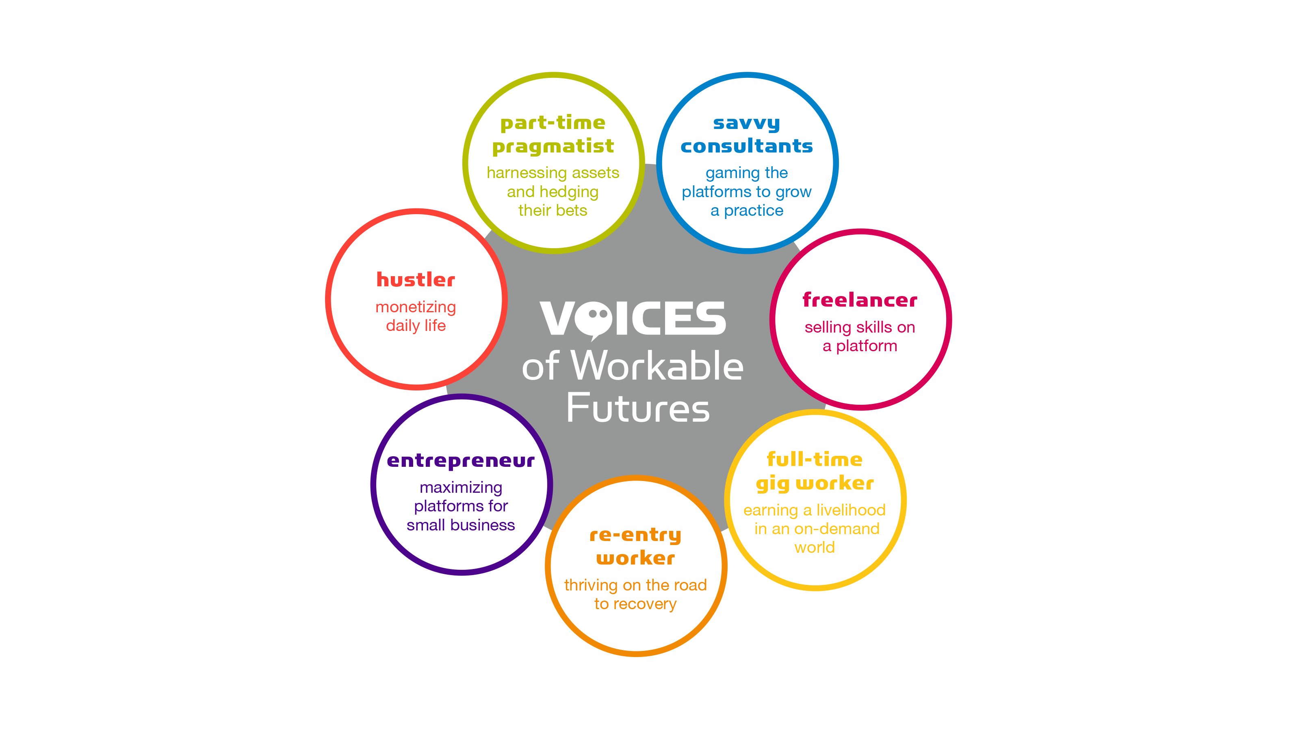

Slide 6
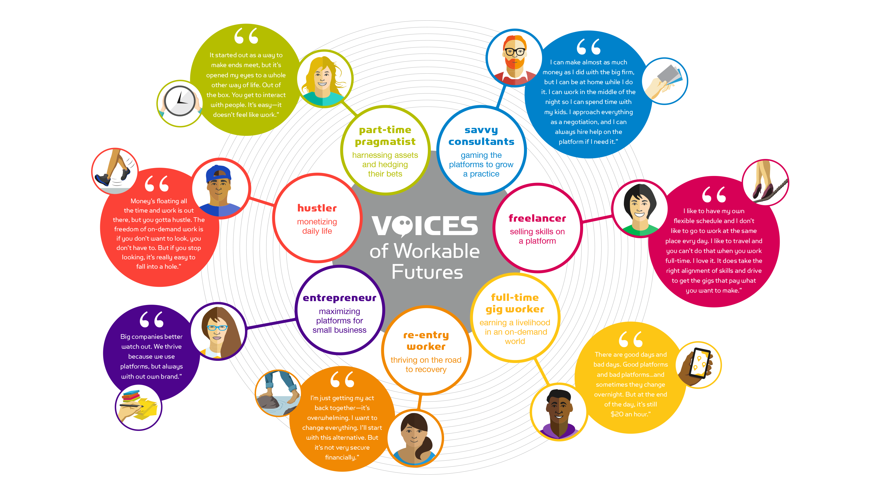

Slide 7
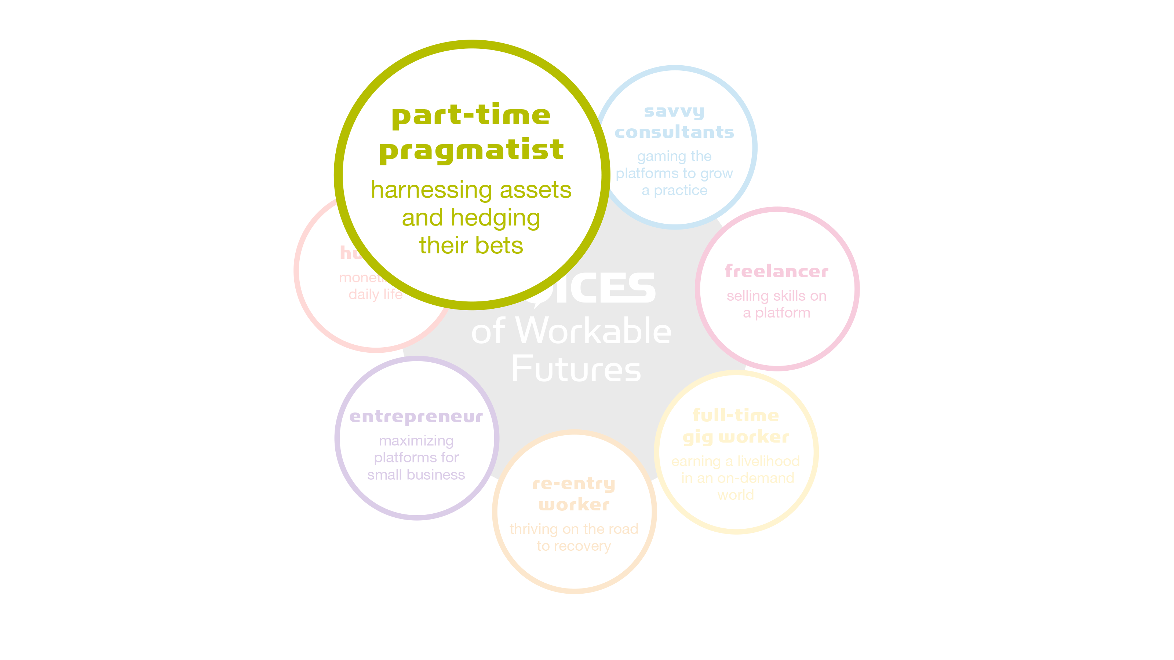

Slide 8
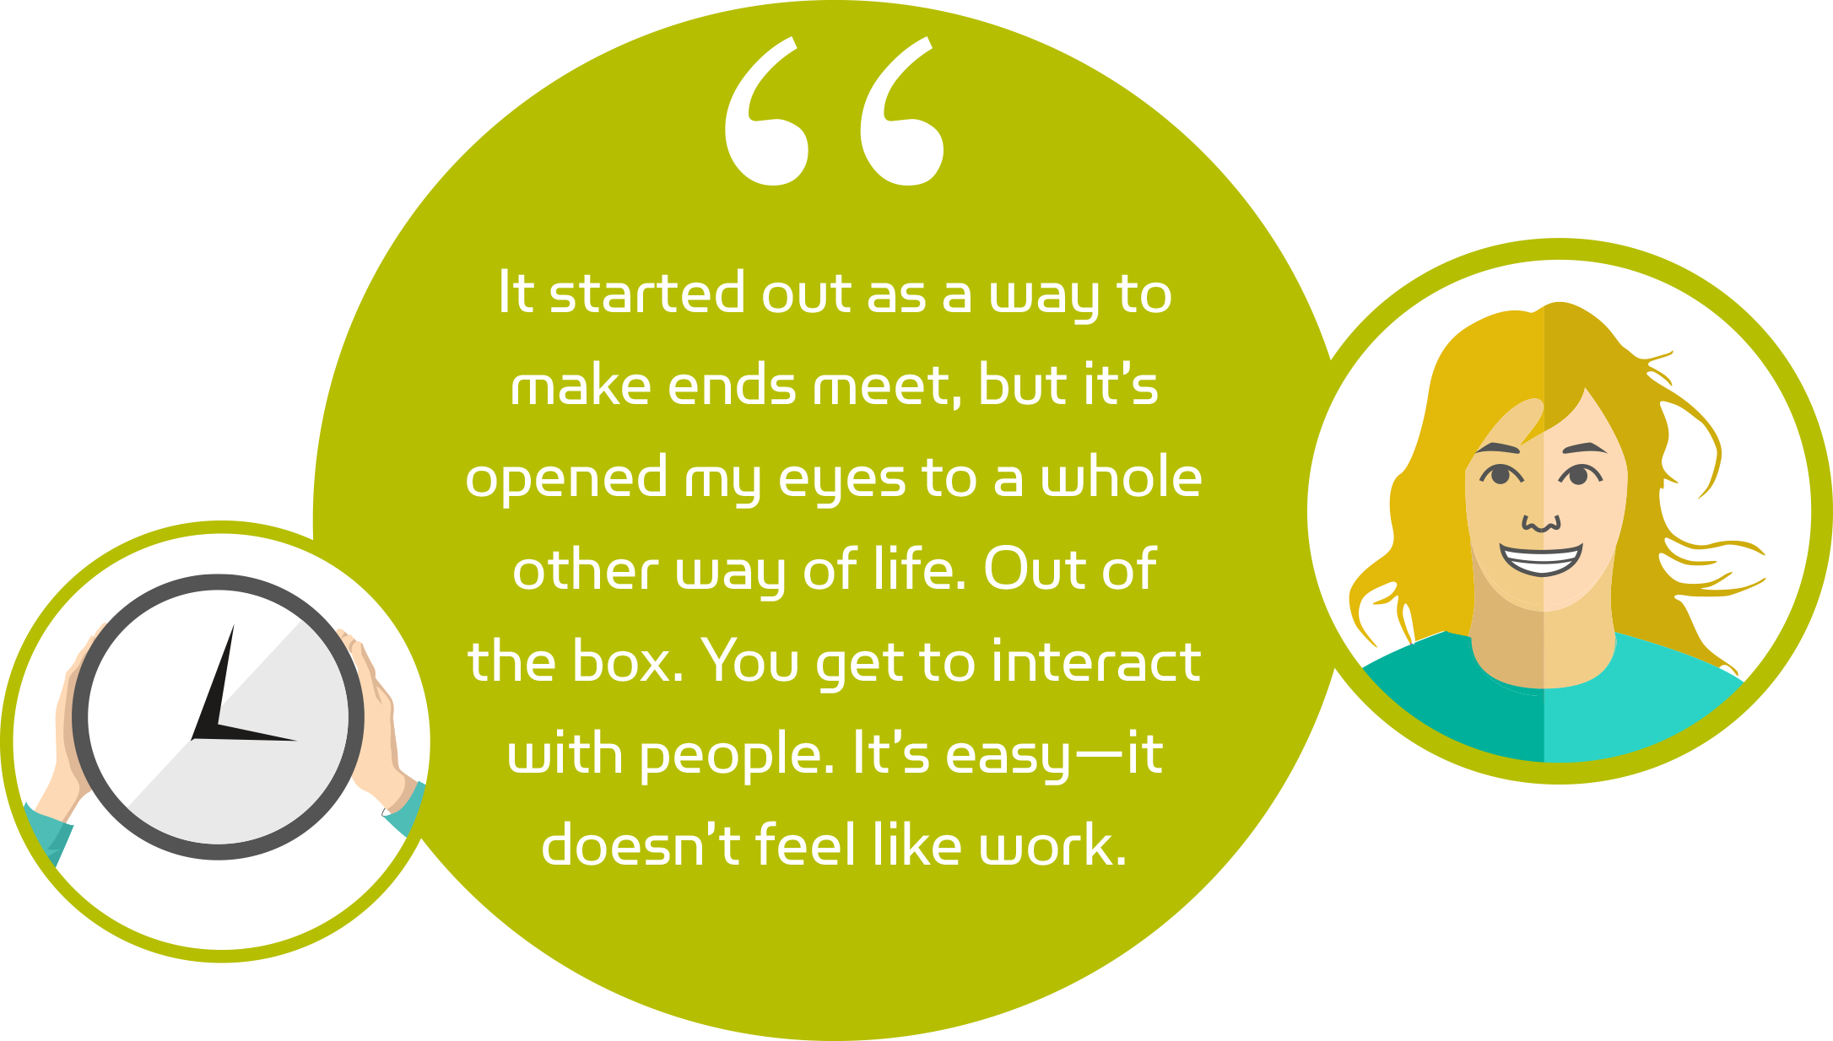

Slide 9
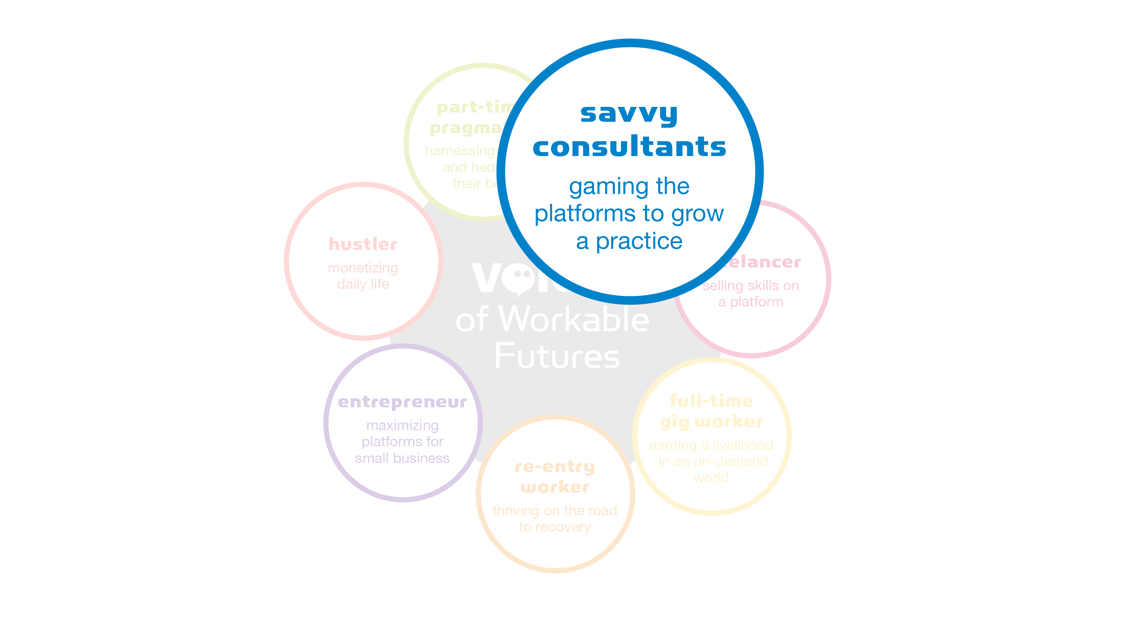

Slide 10
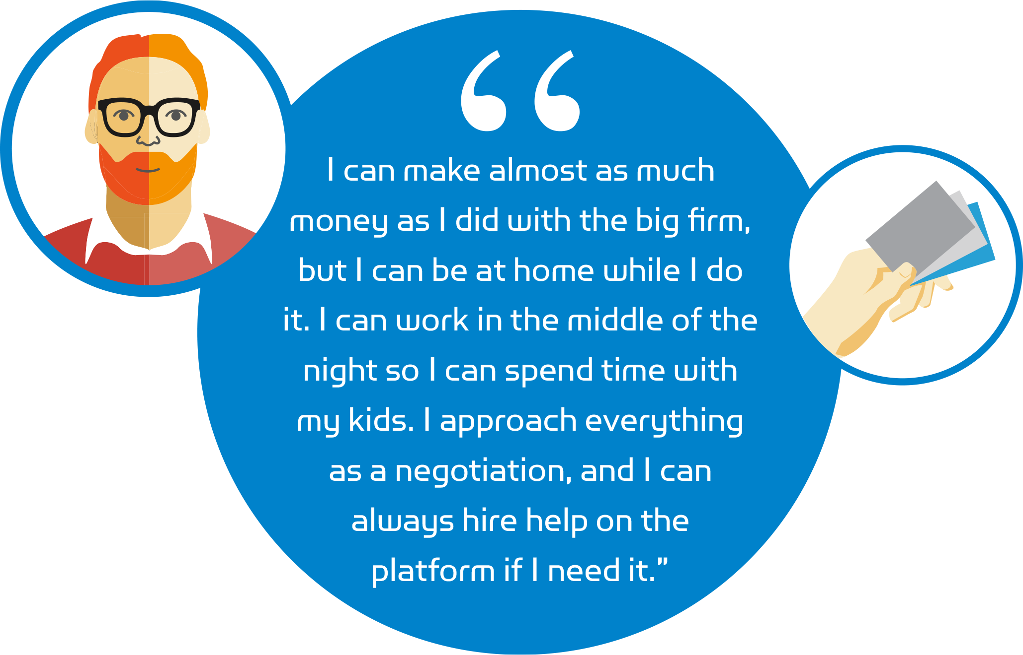

Slide 11
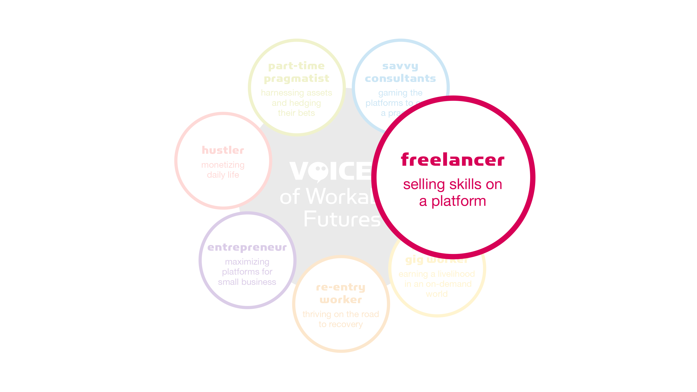

Slide 12


Slide 13
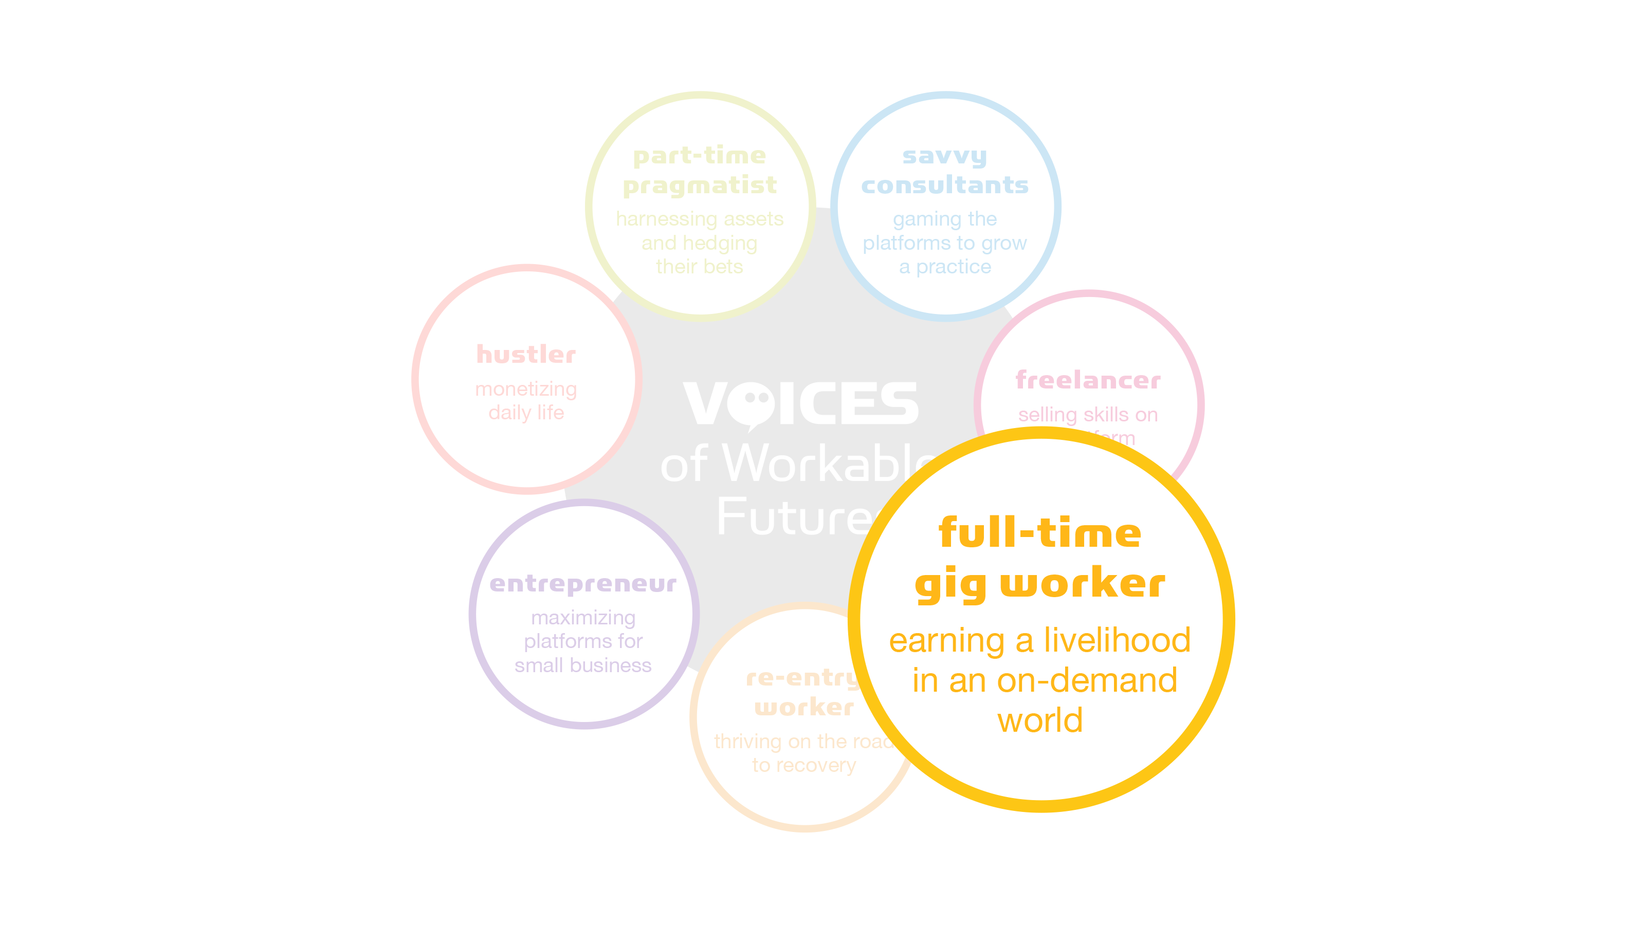

Slide 14
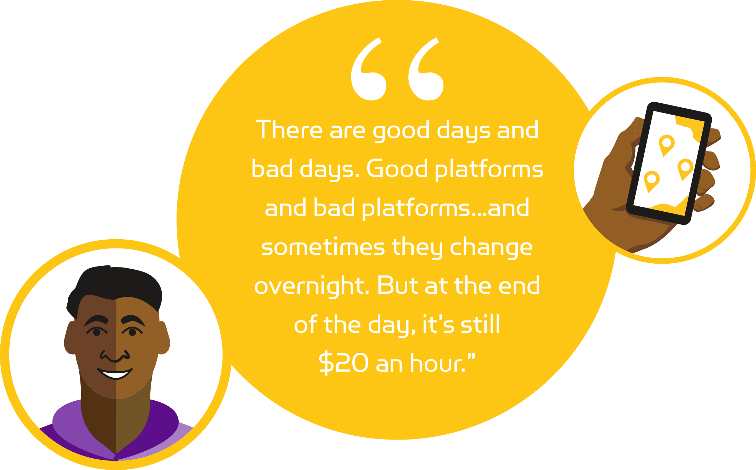

Slide 15
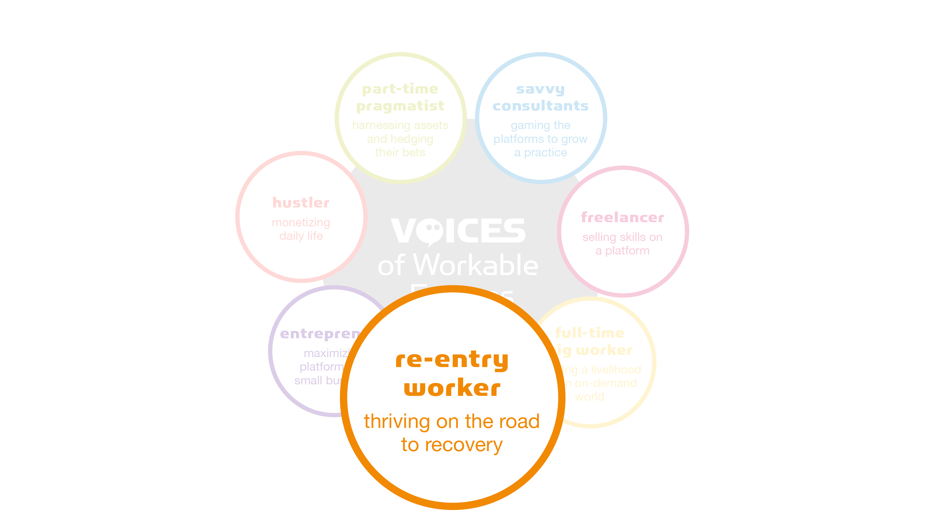

Slide 16
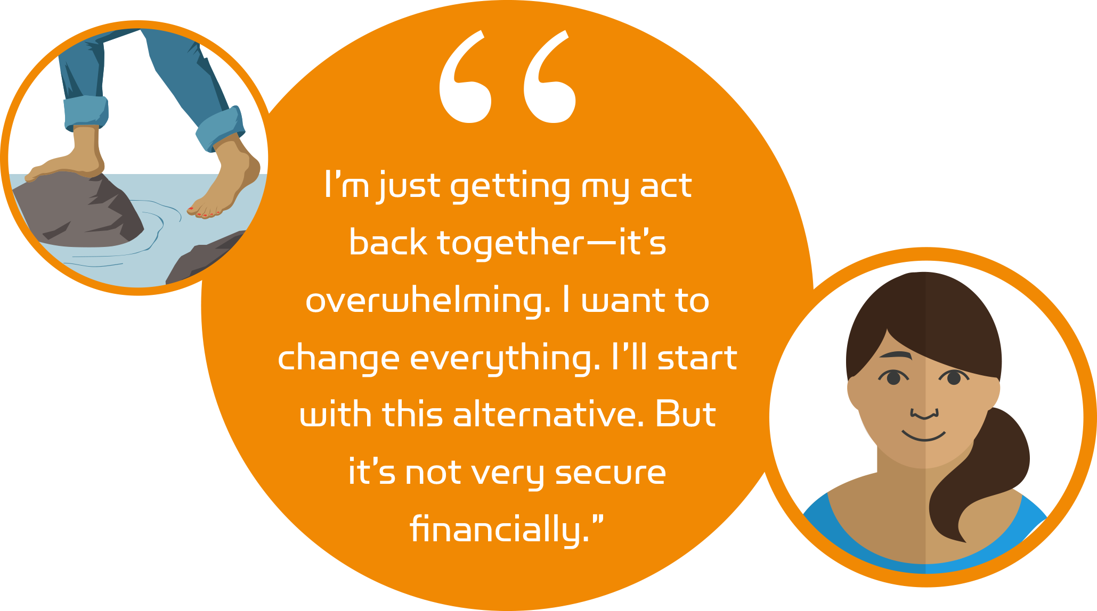

Slide 17
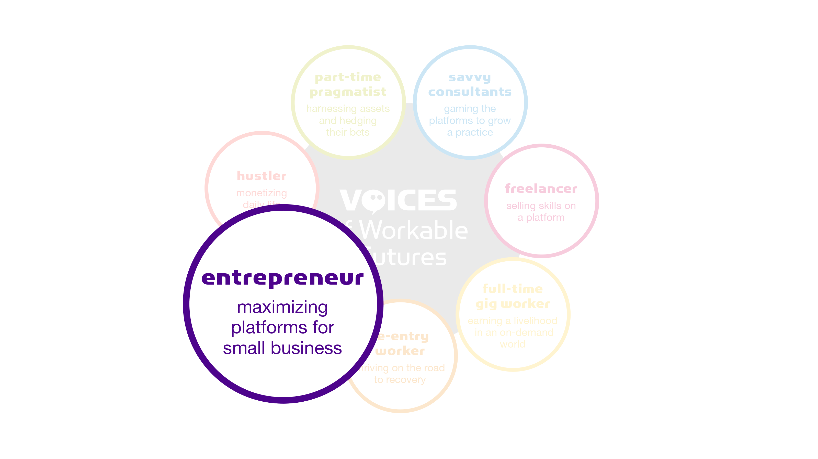

Slide 18
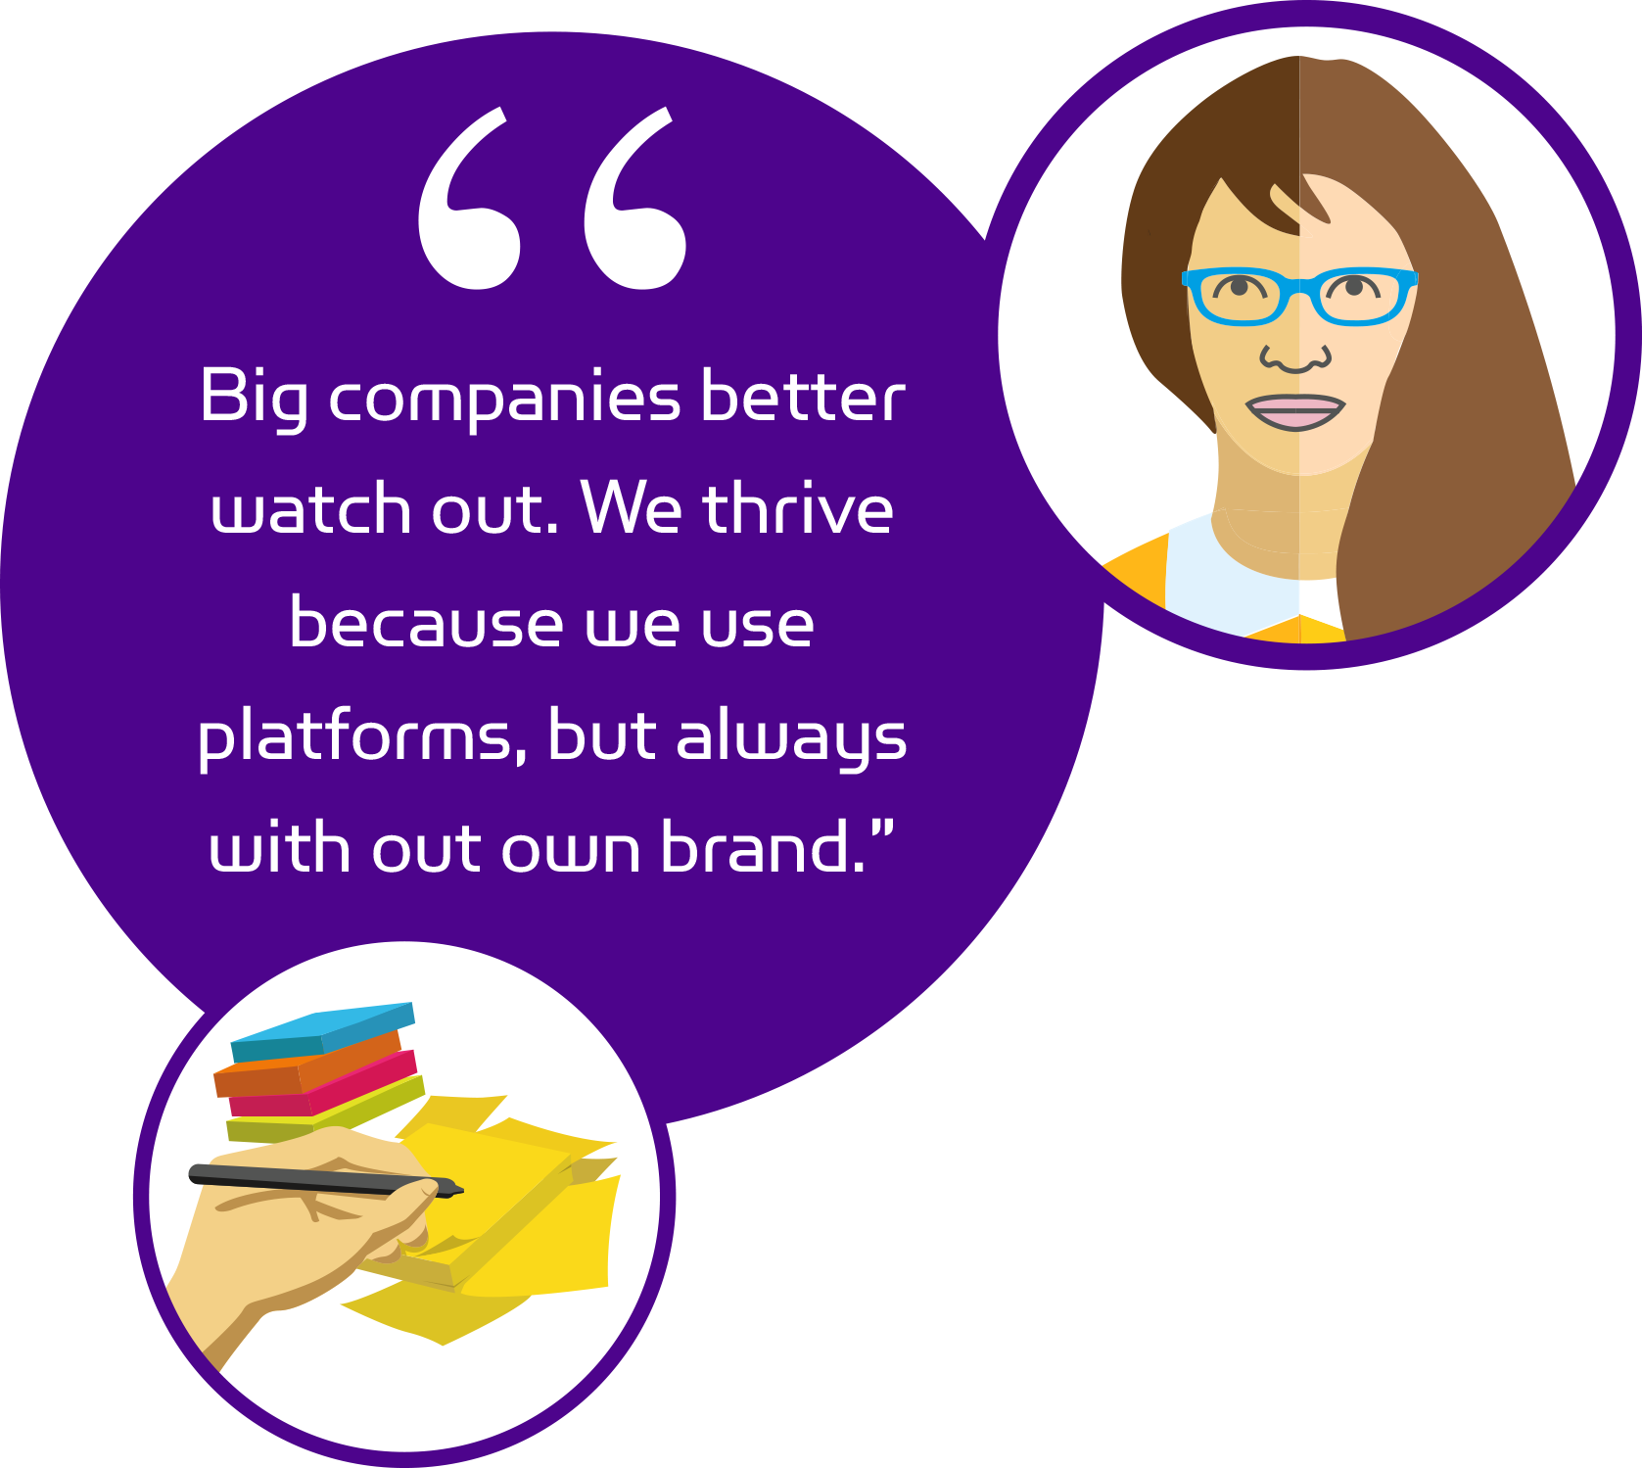
our own brand.”
Notes:
Note: out should be “our”

Slide 19
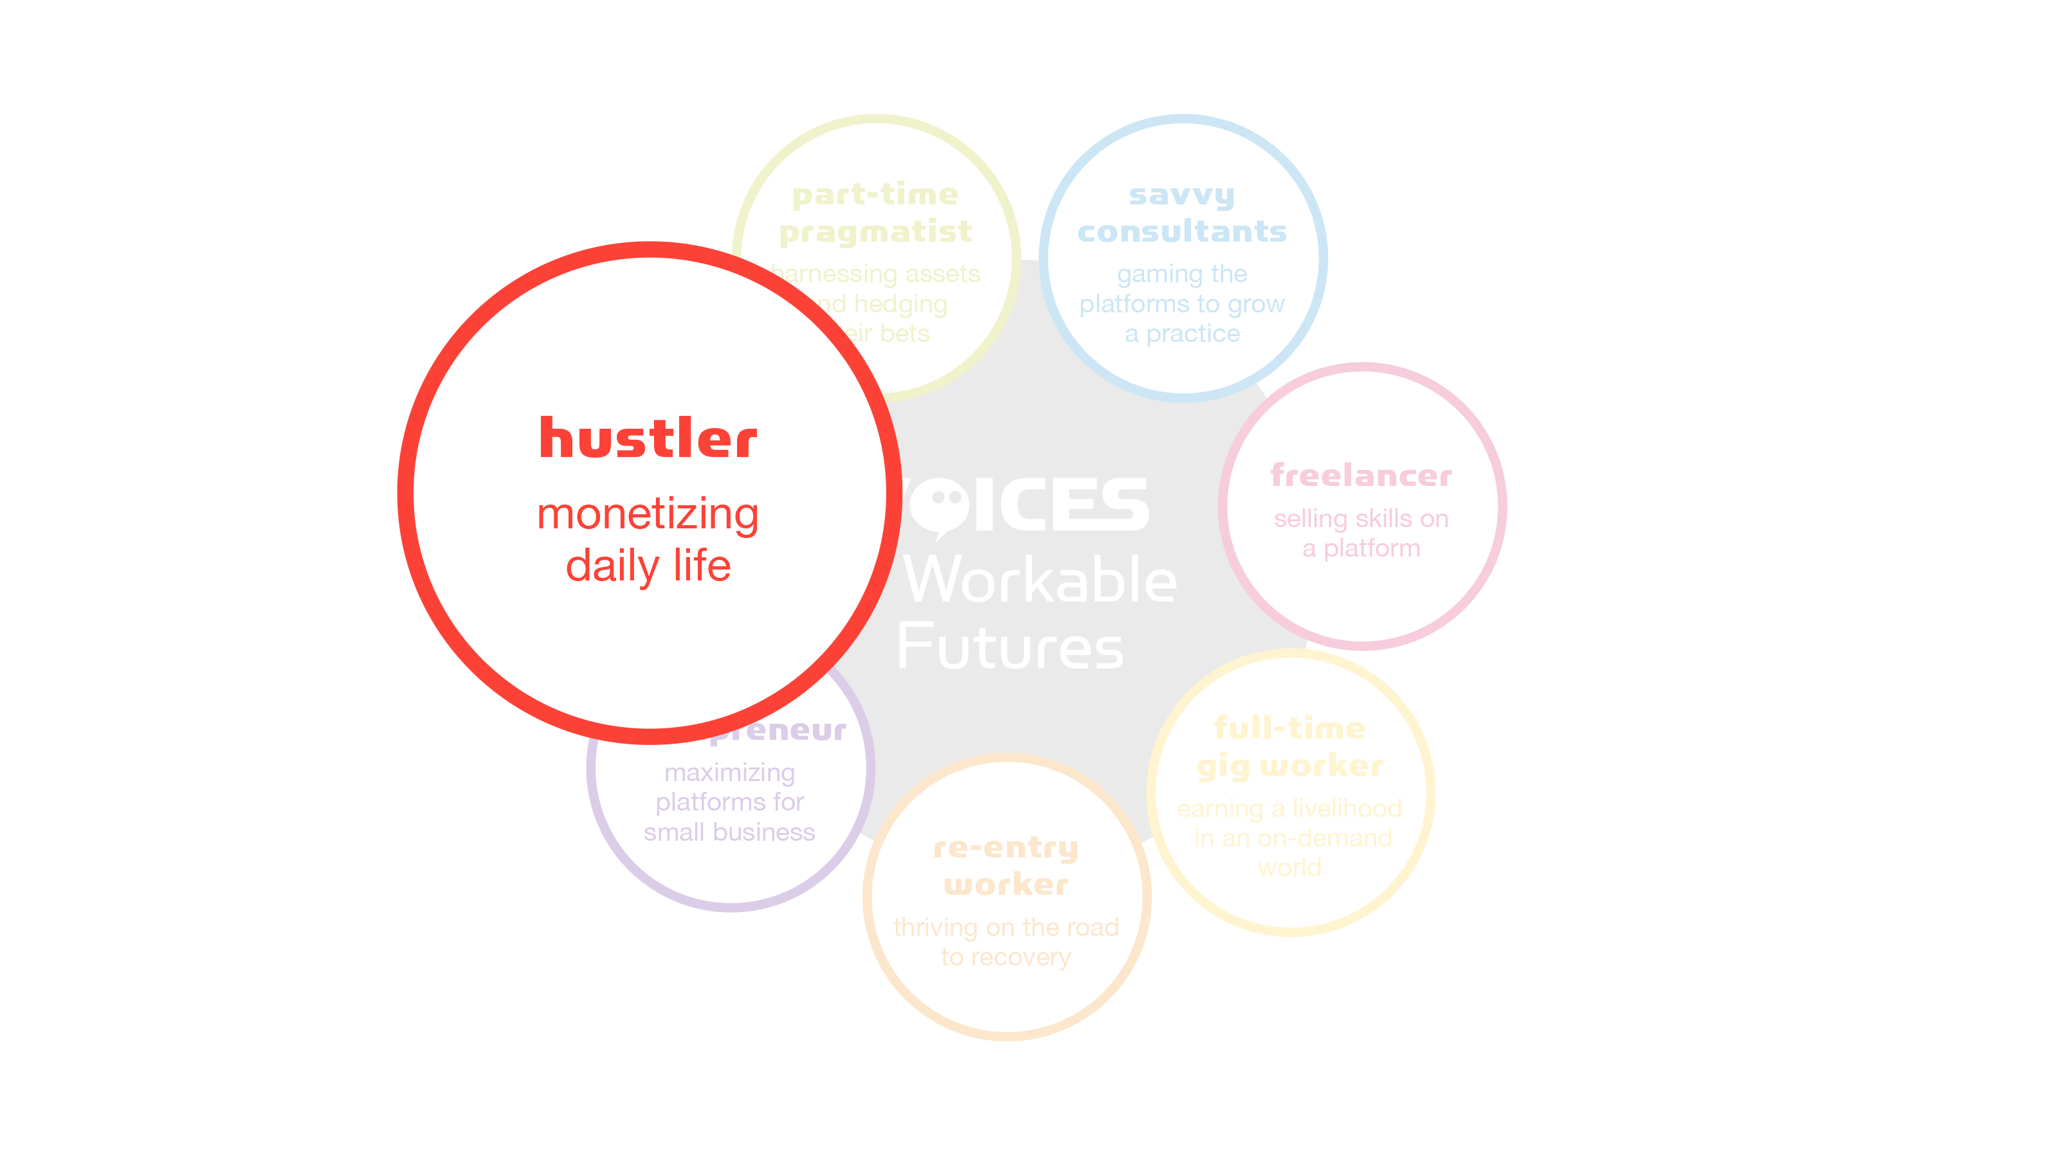

Slide 20


