Slide 1

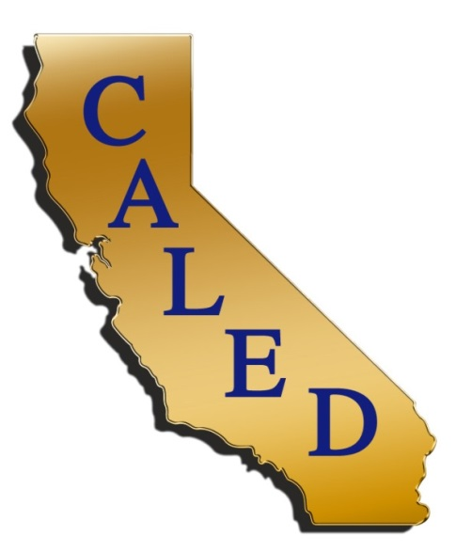
What’s Cooking in a
DIY Economy?
Incubate Your Businesses
Notes:
What do we mean by DIY Economy is to harness the skills and talent in our local communities, rather than depend on attracting the mythical Tesla factory from California. Growing local businesses offers great opportunities to create wealth. Two trends support this – growth of self-employment and microbusiness- Dell
Something CAMEO is committed to … locally grown businesses that are the lifeblood of our communities and we strongly believe that this is the foundation of a stable, sustainable 21st century economy.
No matter what the goal - Job creation, economic sustainability, reducing income inequality, closing the wealth gap – then look no further than in your own backyard and develop the entrepreneurial talent in your region.
DIY Economies will result in sustainable job creation across our diverse communities, both urban and rural. The goal is to scale up what works, to add new methodologies and be inclusive- involve new partners and perspectives.

Slide 2

AGENDA
Brief Overview of DIY and Tools
Traditional Business Incubators
Kitchen Incubators
Cooperative Accelerator
Q&A
www.microbiz.org

Slide 3
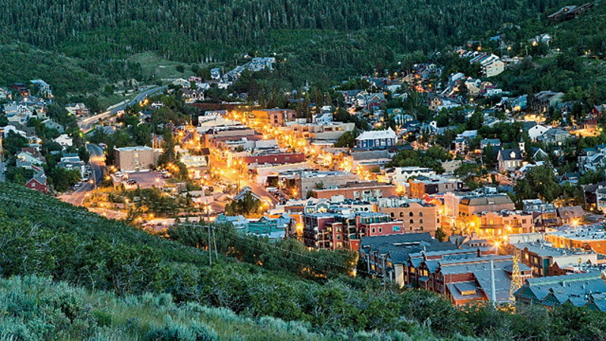
www.microbiz.org
Notes:
Hidden in plain sight. Think of those artisan businesses selling on Etsy: 1 million and over a billion dollars in sales!
Story of Melanie Findling -Quercus Consulting, Mt. Shasta, 12 employees – do environmental consulting
A shift is needed to new innovative, creative and flexible method that will work for today’s economy – a method that is based on creating jobs based in place, one based on DIY economies.

Slide 4

Microbusinesses are the root of all businesses
www.microbiz.org
Notes:
Complete Ecosystems
Only 1% of businesses turn out to be gazelles, fast growth.
The big trees need the sprouts for healthy long-term sustainability

Slide 5
DIY Works
Businesses are starting smaller and staying smaller.
95 percent of all job gains in a year in an average state come from the expansion of existing businesses or the birth of new establishments.
Avg. Number of Employees
New Businesses
www.microbiz.org
Notes:
According to a Bureau of Labor statistics report, to 4.7 employees in 2011.”
http://www.bls.gov/opub/mlr/2012/03/art4full.pdf
http://www.brookings.edu/opinions/2011/0125_regional_clusters_muro.aspx
http://www.ppic.org/main/publication.asp?i=956

Slide 6
Microbusinesses,
THE job creators
2003-2012
 | Micro-businesses (1-4) | Large businesses (500+)
US jobs created | 7 million | (.75 million)
CA jobs created | 920,000 | (200,000)
California had the most net jobs created by microbusiness from 2003-2012.
www.microbiz.org
Notes:
Very small businesses created jobs every year and mostly created more jobs than any other firm size
During 2009 and 2010, micro-businesses were the only firm size that created jobs.
California had the most net jobs created by micro-business, followed by Florida, Texas, New York and Illinois.
92% of the nation’s businesses are microbusinesses
Microbusinesses generate about $5 trillion of our country’s GDP.
AND– these businesses pay more than double the minimum wage
http://www.bls.gov/cew/cewind.htm#year=2013&qtr=1&own=5&ind=10&size=1

Slide 7
How Independents Measure Up with Small Business
Number of Employees
Including Owner
# of Firms
100K
Small Enterprise
100-500
550K
Mid
Market
20-99
1.7M
Main Street
5-19
3.6M
Micro Businesses
2-4
1
17.7M
Independent Workers
(those working half-time or more)
US Census data 2010;, 2100; US BLS data 2011, 2012; Emergent Research estimates
Notes:
15.9 in 2011
16.9 in 2012
17.7 in 2013
Expected to be 23.5 million by 2018
50% of workforce will have beeen self-employed at some point in their career by that time, too.
Technology making Independent work cheaper and easier
Demographic and social shifts
Encore careers
Work/life flexibility
Shifting family structures
Companies increasingly want workforce flexibility
Traditional jobs less attractive and/or harder to find
Independent work perceived as viable; entrepreneurship seen as cool
Definition of Independent Worker:
21+ years old
Works 15+ hours a week
Job status is one of the following:
Self-employed
Fixed-term contract
Independent consultant/freelancer
Work through temp agency
On-call arrangement
Own business w/less than 5 employees
Substantial… $60K average income

Slide 8
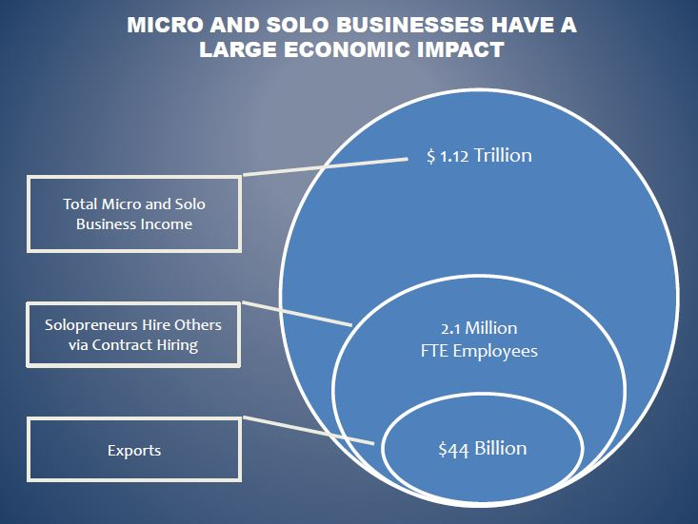
DIY Economic Impact
Notes:
Give kudos to Dell
Capital, Coaching, Connection – Internal to the Biz
Climate – Regulation, Policy
Culture – communities perception (not going to talk about – it’s local and includes things like buy local campaigns, local investment, local pride)
The most important :
*5 C’s actually interact with each other as well as the entrepreneur.
the regulatory and policy climate can influence capital sources.
Culture can influence connections and networks.
Be aware of all this in planning

Slide 9
The Five C’s of the
Entrepreneurship Ecosystem
The Business Owner
Capital Financial Resources
Connec-tion
Resource & Relationship Network
Culture
communities’ perception and support
Climate
Regulation, Economic Development, and Policy
Coaching-Training
Entrepreneur and Owner Skillset
Notes:
Give kudos to Dell Gines at the Kansas City Fed
Capital, Coaching, Connection – Internal to the Biz
Climate – Regulation, Policy
Culture – communities perception (not going to talk about – it’s local and includes things like buy local campaigns, local investment, local pride)
The most important :
*5 C’s actually interact with each other as well as the entrepreneur.
the regulatory and policy climate can influence capital sources.
Culture can influence connections and networks.
Be aware of all this in planning
Business Assistance is the first step in the capital access process
80% who get help succeed + create 2 additional jobs in 2 years
COACHING & TRAINING AVAILABLE THROUGH SBDCS, WBC, AND NONPROFITS
BEST PRACTICE IS HANDS ON LEARNING COMBINED WITH PEER SUPPORT
Do small loans matter:
ACCION Texas 5 year study of micro loans answer: A Lot
Startups receiving funding are dramatically more likely to survive, enjoy higher revenues and create more jobs,” Receiving a microloan can increase a business’s chance of surviving by over 50%.
Connections to Markets
Etsy example- connects home-based artisans to global marketplace.
Specialty Foods- NATIONAL SPECIALTY FOOD ASSOC. HAS HIGH INTEREST IN DIVERSIFYING MEMBERS- FANCY FOOD SHOW, LOCAL TRAINING
Maker spaces- HACKER LAB; INNOVATION LAB- LARRY COPE, ECON. DEV. DIRECTOR CO-CREATED WITH LOCAL BUSINESSES & INVENTORS: VIDEO, PHOTOGRAPHY, 3-D PRINTER, GAME DEVELOPMENT, KITCHEN FOR DEMOS; LOW BUDGET; MARSHALLED LOCAL RESOURCES TO REPURPOSE OLD HOSPITAL.
Inner City Advisors in Oakland
identifies high potential businesses
provides intensive training and technical assistance to spur growth and increase jobs and contracts that will benefit inner city residents.
Want to expand.
Climate – what governments can do: 1) support coaching, capital and connection 2) help businesses navigate regulations by providing information, making sure regulations don’t contradict each other, consider effect on small businesses
Culture – buy local – people support local; community understanding of local

Slide 10
Business Incubators
Lisa Kirvin
Managing Director
Renaissance Entrepreneurship Center
www.microbiz.org
Notes:
Have Lisa take a few minutes to explain her programs
Q: How can cities support business incubators
Possible Questions for later
Q: How easy is it to develop their own where there aren’t any services
Q: Three first steps to take

Slide 11
Kitchen Incubators
Jorge Reguerin
Board President, El Pajaro CDC
Vice President/SBA/RDA Lending
Santa Cruz County Bank
www.microbiz.org
Notes:
Jorge will have a few slides

Slide 12
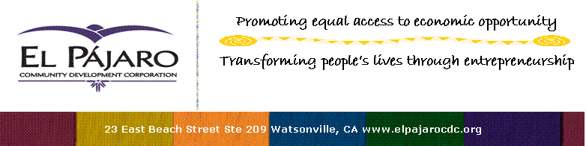
Since 1979
providing assistance to local entrepreneurs

Slide 13
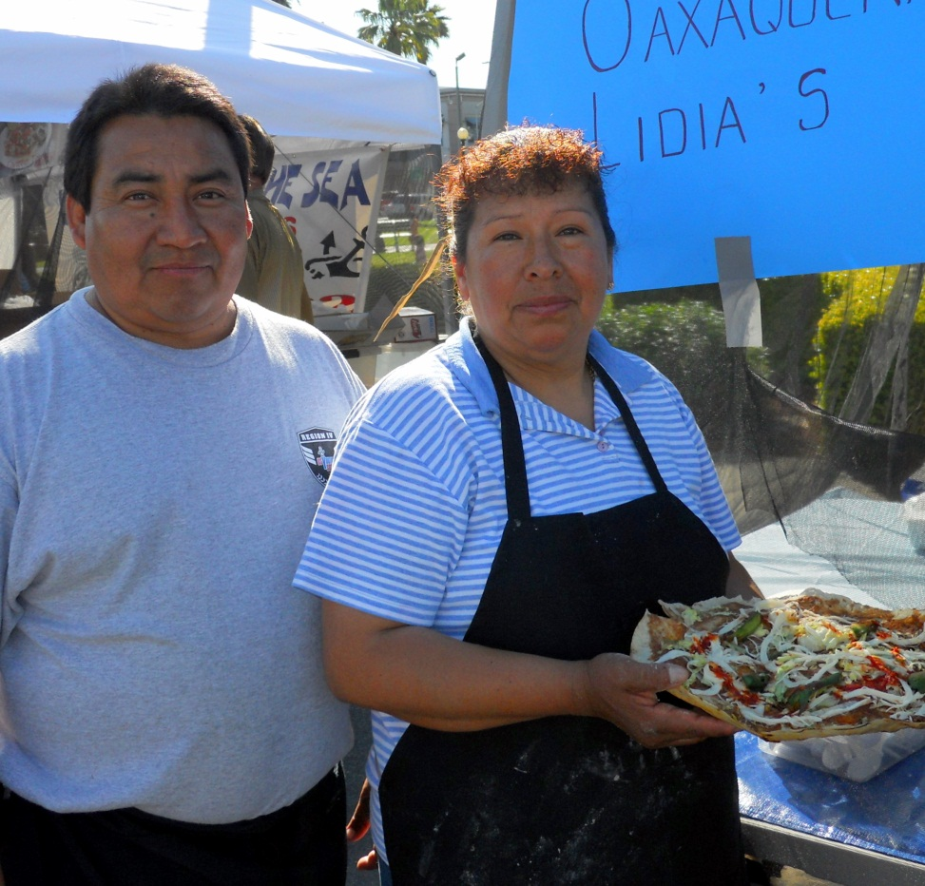
What We Offer:
Start-Up Assistance
Business Coaching
Specialized Business Consultation
Low-Cost Trainings
Commercial and Agricultural Loan packaging
Marketing Assistance
Strategic Planning and Expansion
Business Incubation
Taqueria Lidia
Watsonville Farmer’s Market and the Watsonville Metrocenter

Slide 14

Programs
Business Education & Loan Program
Family Child Care Development
Plaza Vigil Retail Incubator
Commercial Kitchen Incubator
Micro-Lending Collaboration w/SCCCU

Slide 15
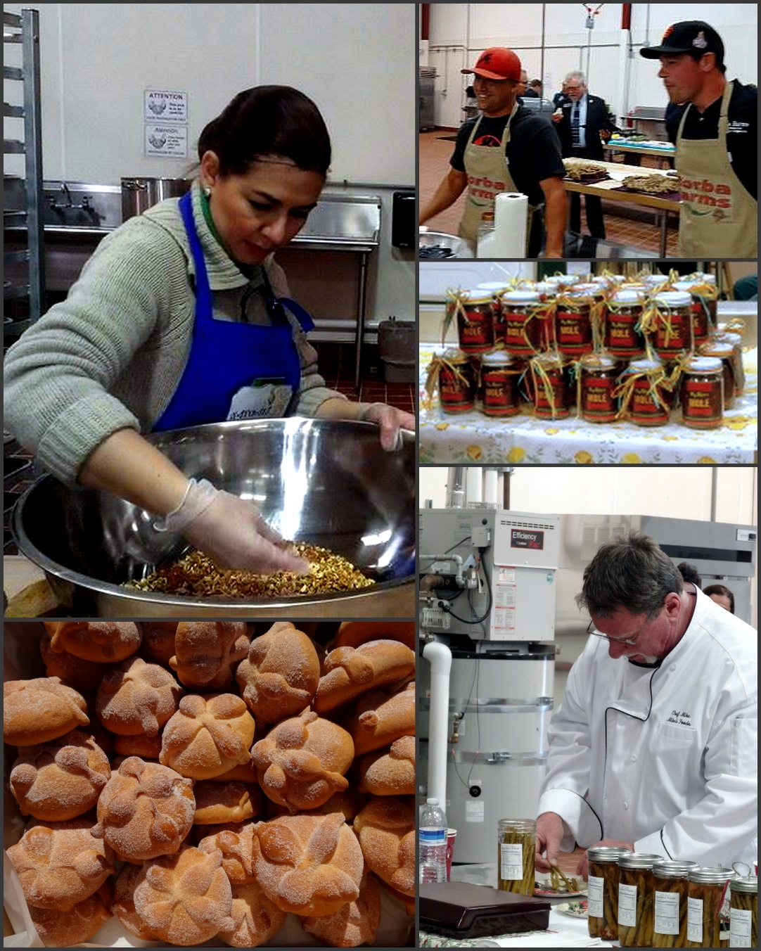
EPCDC
Commercial Kitchen Incubator

Slide 17
Local Community Profile
Unemployment rate is twice the national average
Rural Community
Large number of small family farms

Slide 18
Objectives of the Kitchen Incubator
Job Creation in the Tri-County area: Santa Cruz, Monterey and San Benito Counties
Provide a facility to small family farms to create added value products.
Transform informal food producers into formal food micro enterprises
Offer a facility that has all health permits and food safety requirements

Slide 19
Challenges in starting up a Kitchen Incubator
Facility Location
Concept design for a commercial kitchen
Building permits process
Funding Sources for project
Program structure
Hiring a kitchen incubator manager/coordinator
Outreach and recruitment of participants

Slide 20
Applying to CKI Program
New Food Business Idea
Business Plan Training
Business Plan
No
Yes
Market Readiness Assessment
Yes
ServSafe Training
Food Safety Manager Certification
No

Slide 21
Outcomes
Currently, the Kitchen Incubator has 22 businesses
Average number of jobs created by each business is 4, resulting in 88 new jobs
Six new participants that area going through application process

Slide 22

Carmen Herrera - Mansir
El Pájaro Community Development Corp.
23 E. Beach St. Watsonville
cherrera@elpajarocdc.org
info@elpajarocdc.org
www.elpajarocdc.org
831-722-1224

Slide 23
Cooperative Accelerator
Rani Croager
Co-Founder, Lead Instructor & Mentor
Uptima Business Bootcamp
www.microbiz.org
Notes:
Q After leaving a career in investment banking, you moved into something that was closer to your heart in the social and economic justice arena. One of your first projects was to start a hybrid for-profit/ non-profit / community college alternative. Can you tell us what you learned?
profit (unprepared students/student debt) vs non-profit (great mission/can't execute)
Q: What was the business model you developed as a result and why didn't the VC's want to fund it
Multi-stakeholder Coop
Q That led you to think about how to better serve small businesses ... that there's something between tech-focused accelerators like Y-combinator and non-profit business development services
holistic approach and program description and your business model
Q Outcomes
Businesses, jobs, etc..
Other Questions
What cities can do to support and foster such types of business incubators
Is there something that economic development professionals can do to help your organization
How can you work with the city to incubate/accelerate more businesses

Slide 24
Resources
Grow Your Own Guide, Federal Reserve Bank of Kansas City
https://www.kansascityfed.org/publicat/community/gyo/gyo-guide.pdf
2014 State of Independence Report, MBO Partners
http://www.mbopartners.com/state-of-independence/independent-workforce-index.html
Bigger Than You Think, Association for Enterprise Opportunity http://www.aeoworks.org/index.php/site/page/bigger_than_you_think_the_economic_impact_of_microbusiness_in_the_united_st
DIY Economic Development
Heidi Pickman and Claudia Viek, IEDC Economic Development Journal
http://www.iedconline.org/documents/members-only/do-it-yourself-economic-growth/
A Grassroots Approach to Economic Development, BALLE
https://bealocalist.org/grassroots-approach-economic-development
How Much Does Credit Matter
http://www.microbiz.org/how-much-does-credit-matter/

